Slide 1
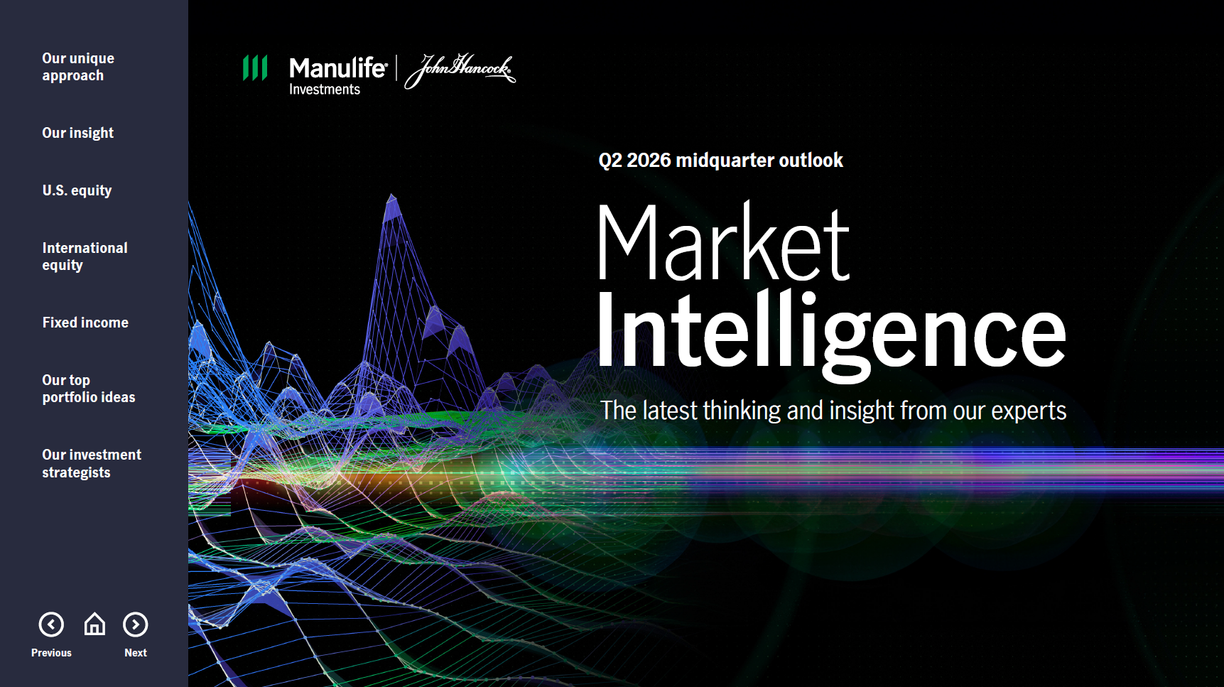

Slide 2


Slide 3
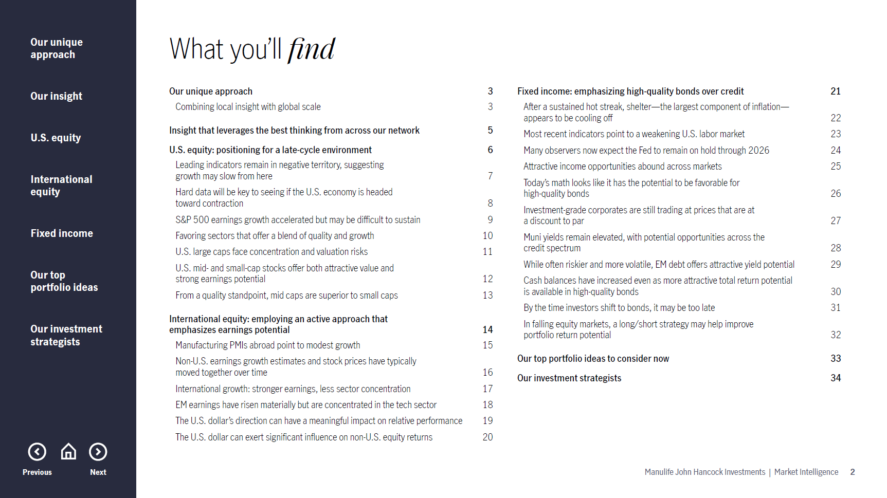

Slide 4
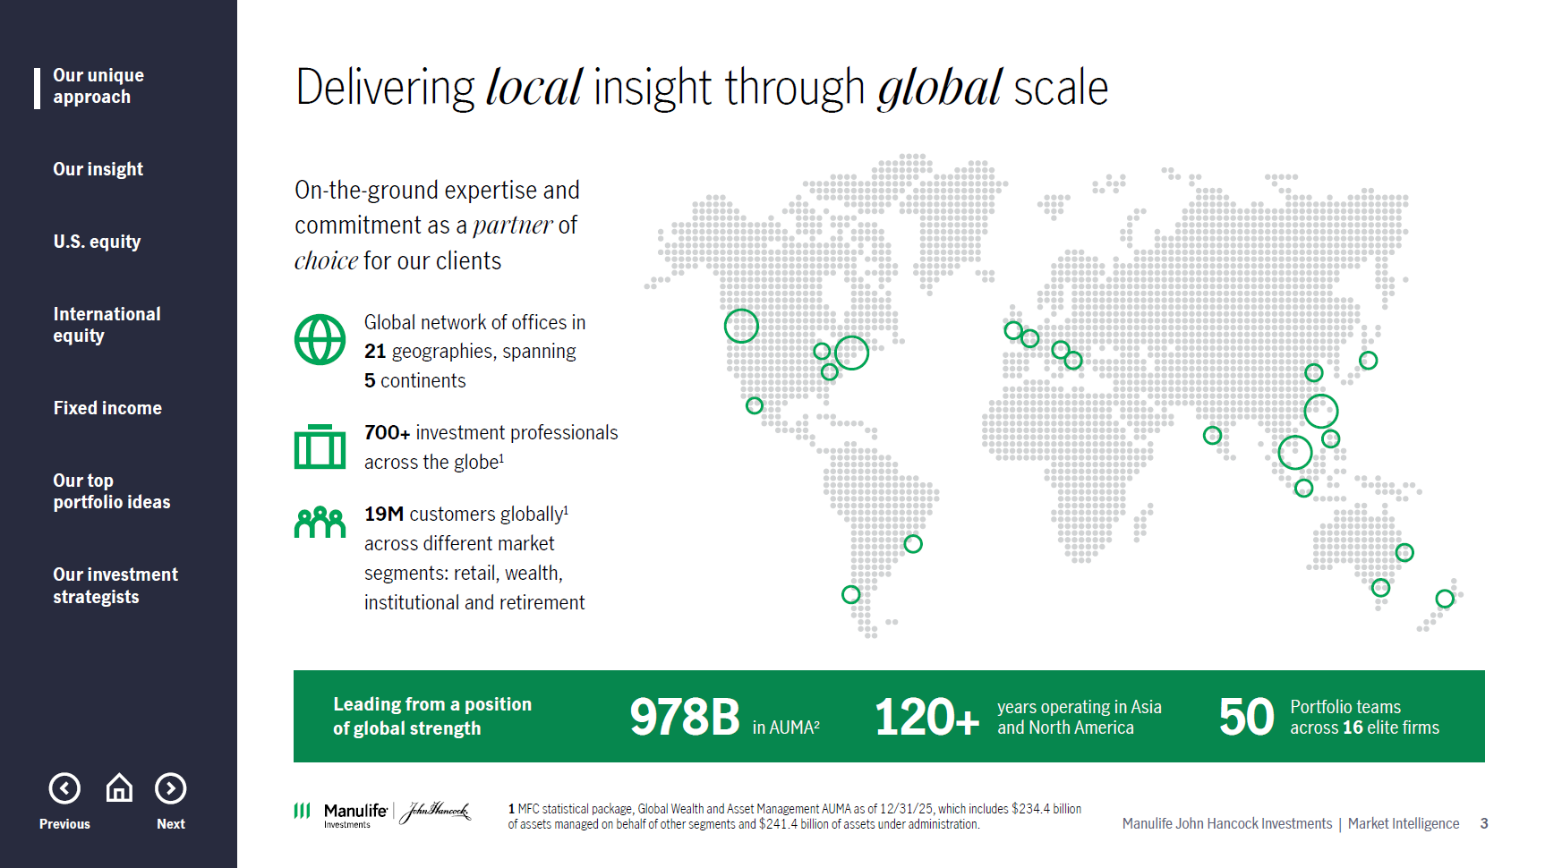
Notes:
Slide 3
Let me start by briefly explaining how we build our views. Manulife John Hancock Investments sits within Manulife Wealth & Asset Management, a global organization with $978 billion in assets under management and administration. That scale gives us access to deep global resources to help inform investment decisions.
Our views are shaped by insights from over 700 investment professionals across five continents, including portfolio managers and analysts with real-time market perspective, economists focused on macro trends, general account teams offering institutional fixed-income insight, and research partners in regions such as Japan and Canada. Together, these inputs provide strong depth and diversity of thought behind our market and asset allocation views.

Slide 5
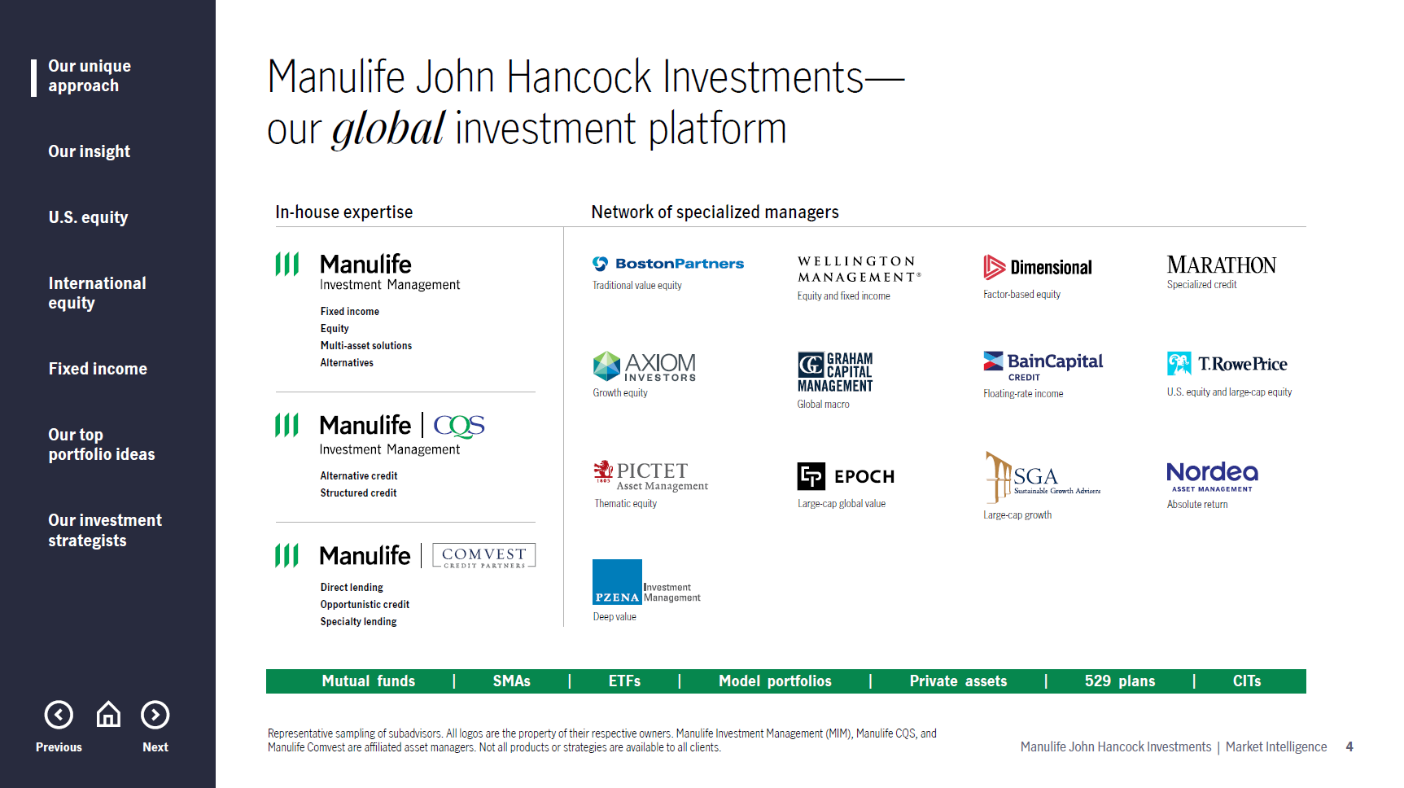
Notes:
Slide 4
Building on the importance of thought diversity, we leverage the significant resources of Manulife Investment Management while also hiring external managers where specialized expertise is needed. A dedicated global team identifies, selects, and continuously monitors these managers to ensure they meet our expectations. We work closely with that team to gain regular insight into portfolio positioning, and the intelligence from this diverse group of institutional investors is a key input into our Market Intelligence views.

Slide 6
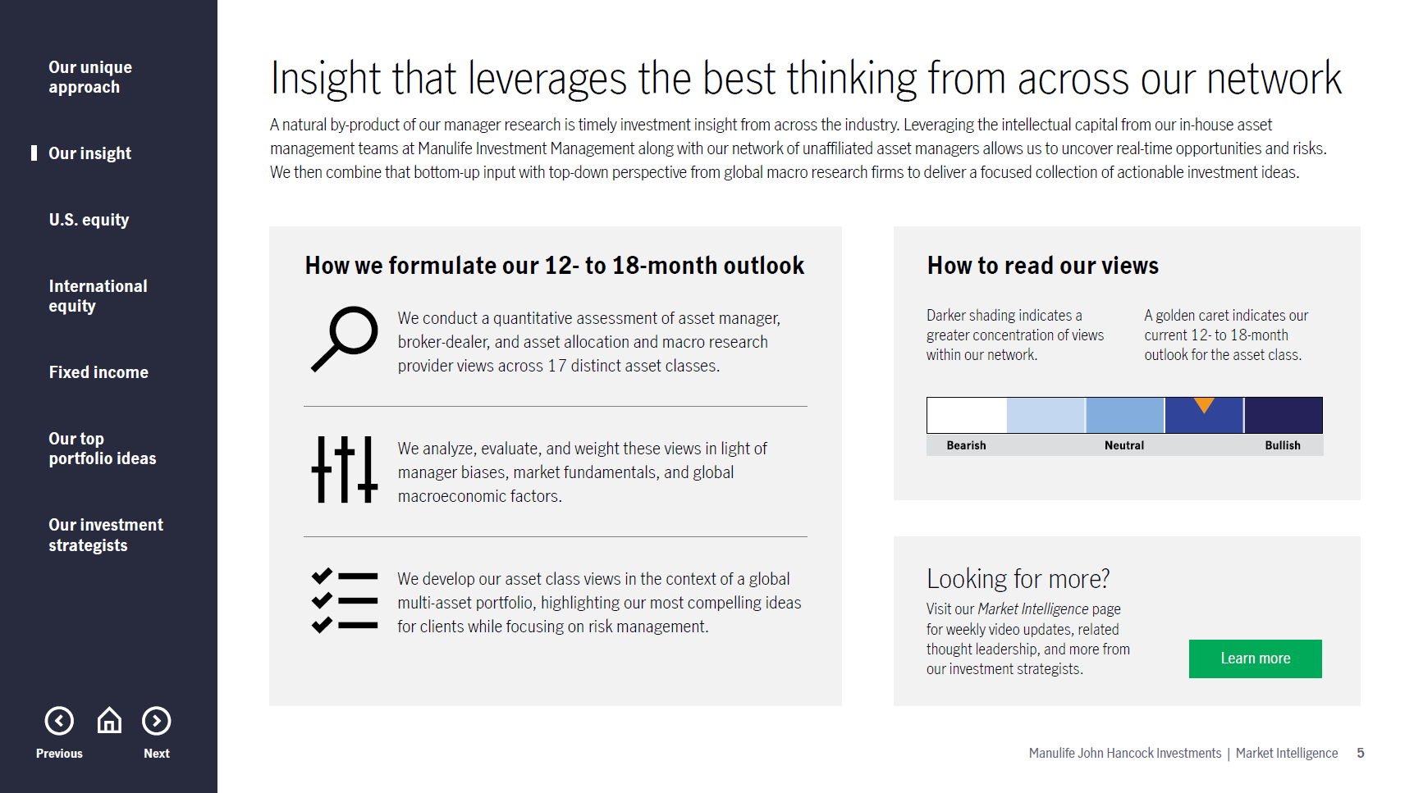
Notes:
Slide 5
So, how do we leverage this network to create and update Market Intelligence? On the left is an overview of our three‑step process. First, we conduct a quantitative review of investment strategist, asset manager, and broker-dealer views across 17 asset classes to establish a baseline consensus. Next, we assess quarter‑over‑quarter positioning changes, remove identified biases, and layer in our own analysis of economic and earnings data to develop a view on the macro regime. Finally, we express these outlooks within a multi-asset framework—roughly 60% equities and 40% fixed income—over a 12‑ to 18-month time horizon, with risk management at the core of each decision. Market Intelligence features three sections: U.S. equities, non‑U.S. equities, and fixed income. The illustration on the right, which you will see throughout the presentation, shows the range of views across our network, with darker shading indicating greater consensus. The gold caret represents the Manulife John Hancock Investments view.

Slide 7
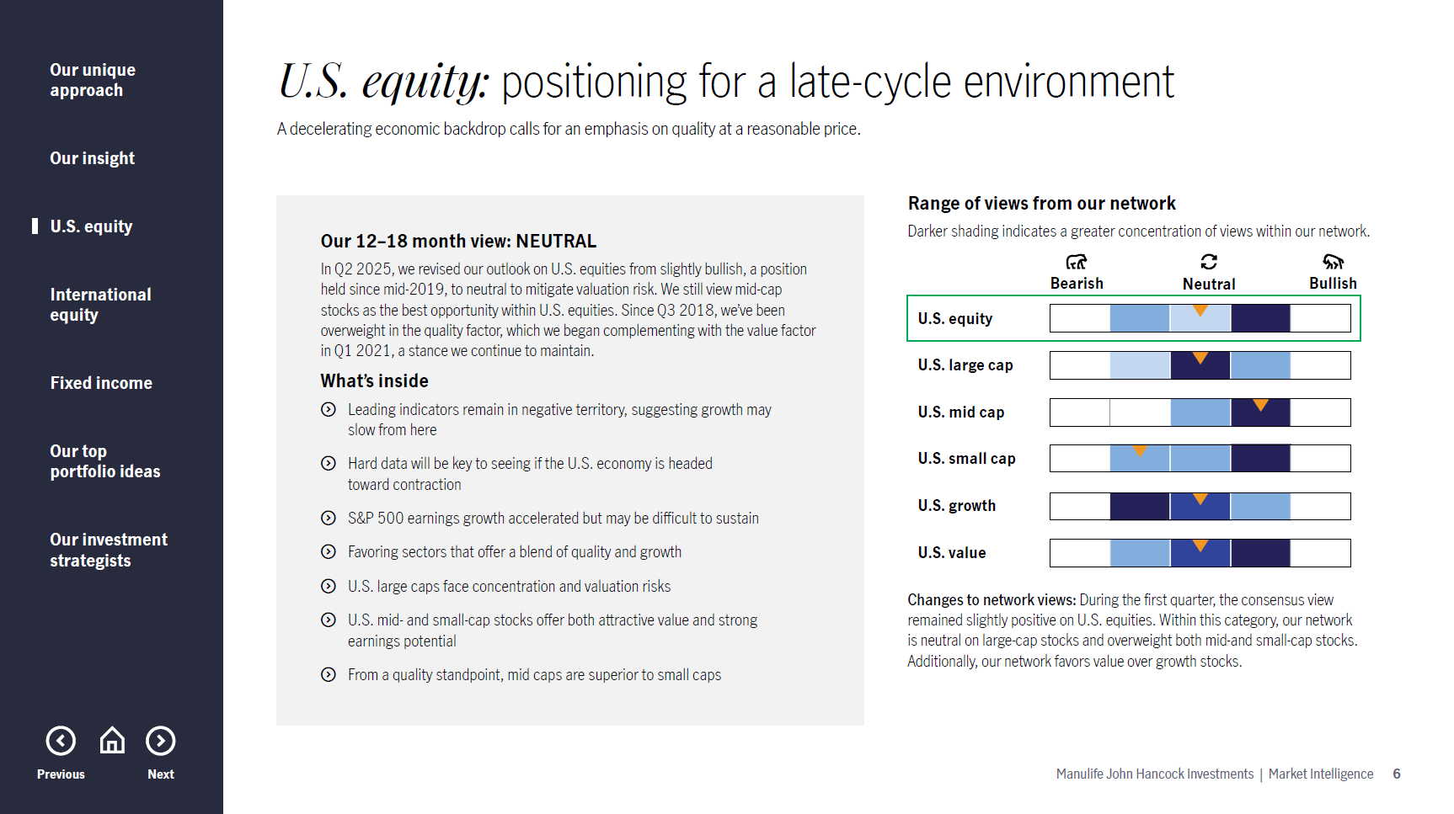
Notes:
Slide 6
In Q2 2025, we shifted our outlook on U.S. equities from slightly bullish to neutral to account for valuation risk—a stance we continue to maintain today. Within U.S. equities, we remain neutral on large‑cap stocks, overweight mid‑cap stocks, and slightly bearish on small‑cap stocks. From a style perspective, we’re currently neutral on both growth and value.

Slide 8
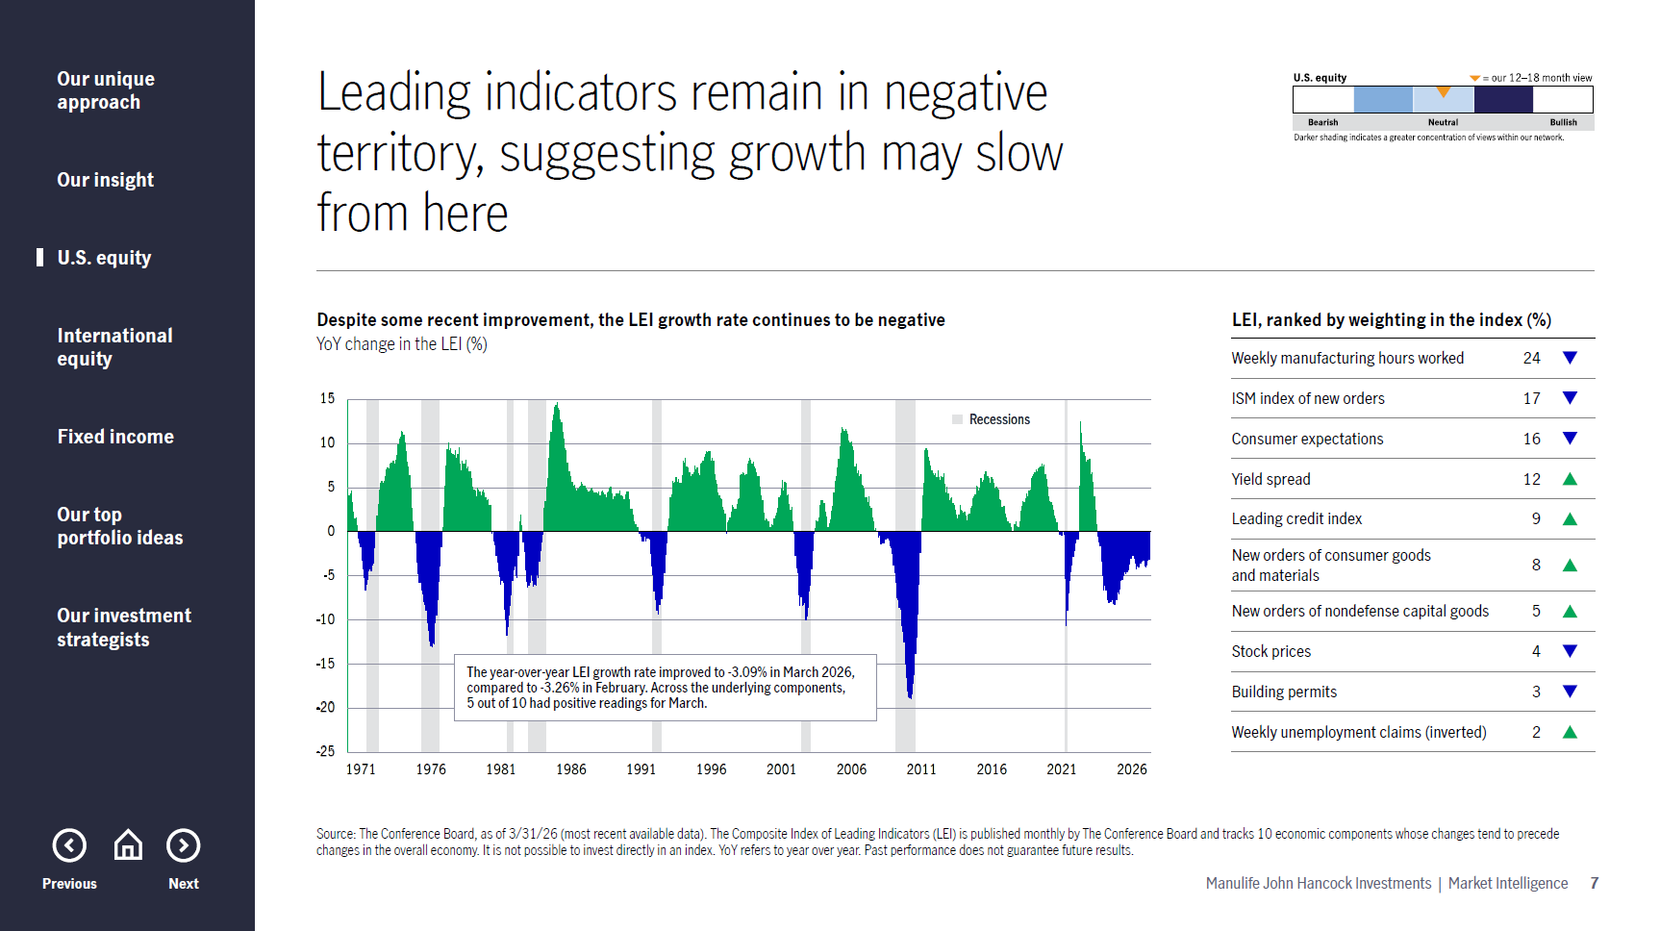
Notes:
Slide 7
Let’s frame the U.S. equity discussion within the context of the U.S. economy. One way we assess economic momentum is through leading economic indicators, or LEIs, which have historically been reliable signals ahead of recessions. As shown by the blue bars, contractionary LEI readings have preceded each of the past seven U.S. recessions over the last 50+ years.
Most recently, the year‑over‑year LEI growth rate improved modestly to ‑3.09% in March 2026 from ‑3.26% in February. Five of the ten underlying components posted positive readings. Areas of weakness include consumer expectations and the ISM index of new orders, while strength has emerged in new orders of consumer goods and materials and the leading credit index, among other areas.
Notably, LEIs have remained negative on a year-over-year basis for approximately four years without a recession—an unprecedented historical pattern. As a result, we continue to view the economy as being in an extended late‑cycle phase, where growth could slow from here. We’re positioned accordingly, with portfolio overweights in higher‑quality areas of the market.

Slide 9
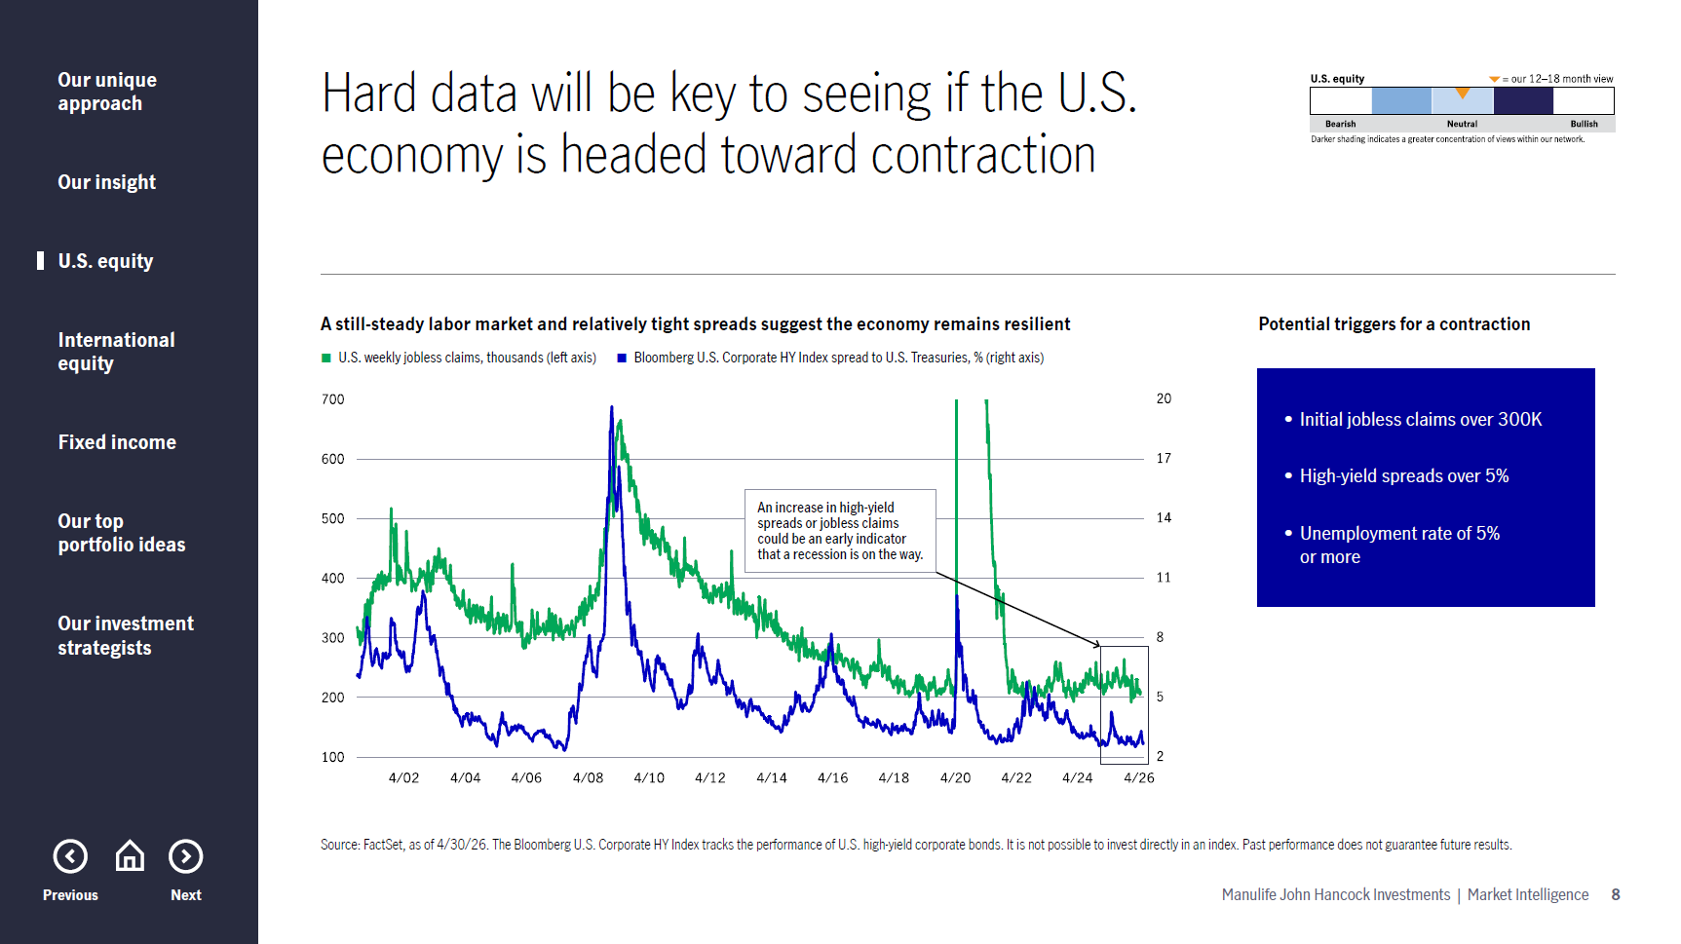
Notes:
Slide 8
We’re closely monitoring several key indicators to determine whether portfolios should begin positioning for an economic contraction. One of the most important is initial jobless claims, which have historically been a reliable early signal ahead of U.S. recessions. A sustained move toward roughly 300,000 claims would suggest deeper stress in the labor market than we’re seeing today. At the same time, high‑yield credit spreads remain relatively tight by historical standards, indicating that credit markets are not currently pricing in elevated default risk. If hard economic data begins to weaken more meaningfully, that could serve as an early warning sign of a potential recession. With that in mind, we’ll continue to closely monitor incoming data in the months ahead.

Slide 10
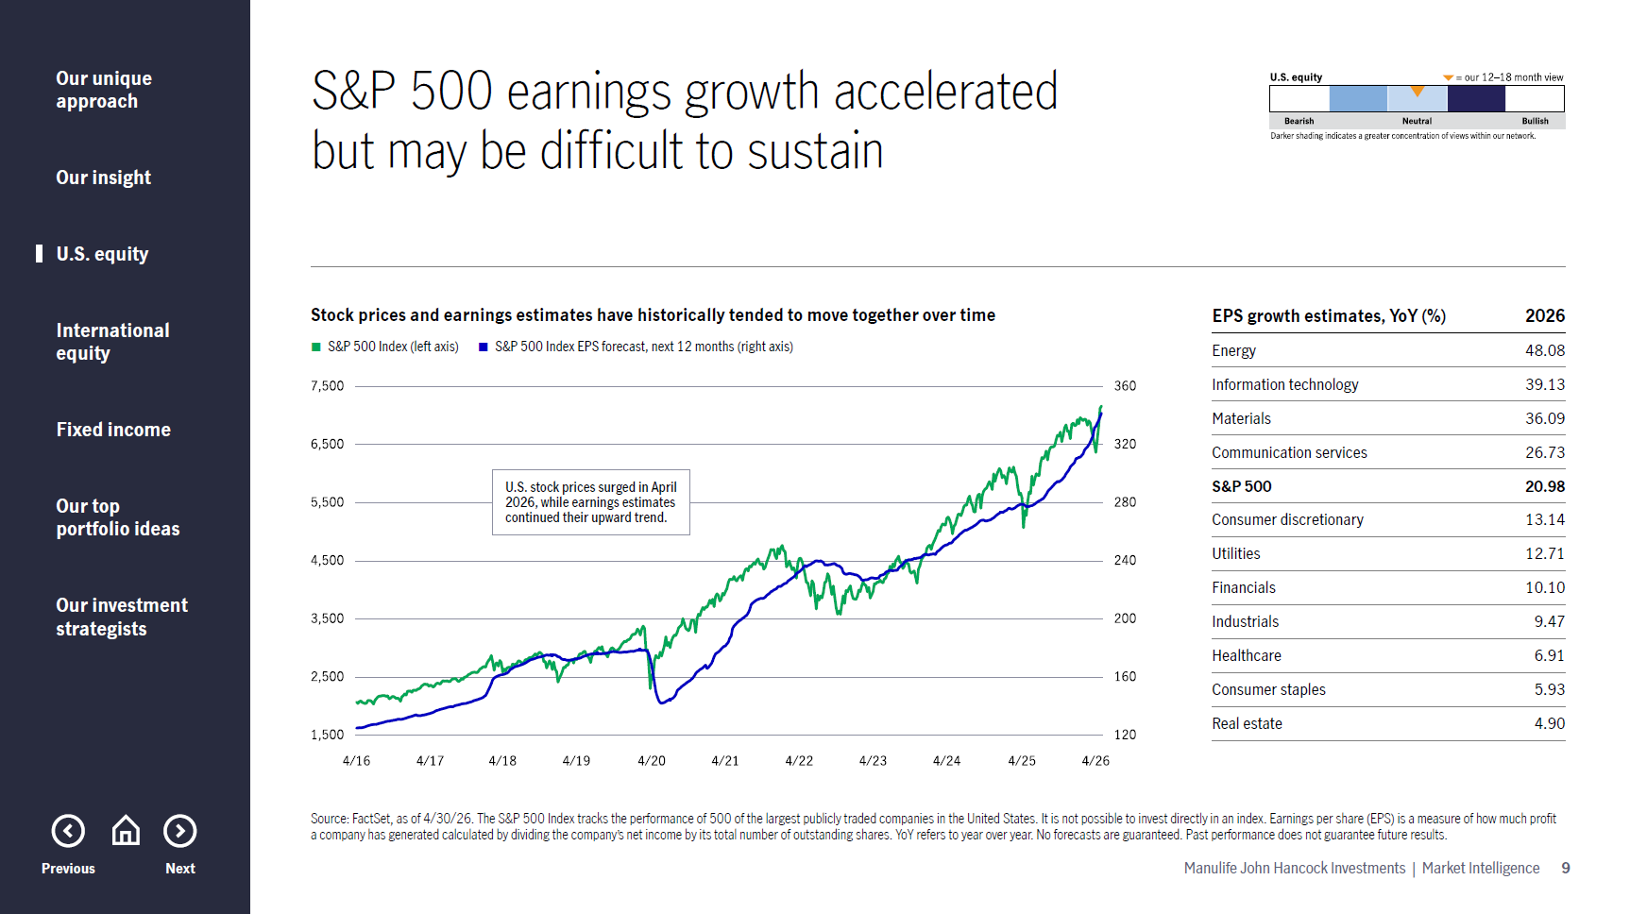
Notes:
Slide 9
Another important macro trend we continue to monitor is the relationship between corporate earnings expectations and equity prices. While U.S. stock prices have continued to move higher over the past year, despite a pullback in the first quarter of 2026, earnings growth estimates have also trended steadily upward. As shown here, the blue line represents the next 12‑month earnings estimates for the S&P 500 Index, while the green line represents the index’s price level. Historically, these two series tend to move together over time.
Continued strength in earnings estimates could reflect growing optimism among equity analysts, although expectations vary meaningfully by sector, making a sector‑level view especially important.
On the right, we show year‑over‑year EPS growth estimates for both the S&P 500 overall and by sector for 2026. The S&P 500 is currently expected to deliver EPS growth of around 21%, with energy and information technology among the sectors projected to see even stronger growth. It’s also worth noting that U.S. earnings expectations remain relatively higher than in many other global markets.

Slide 11
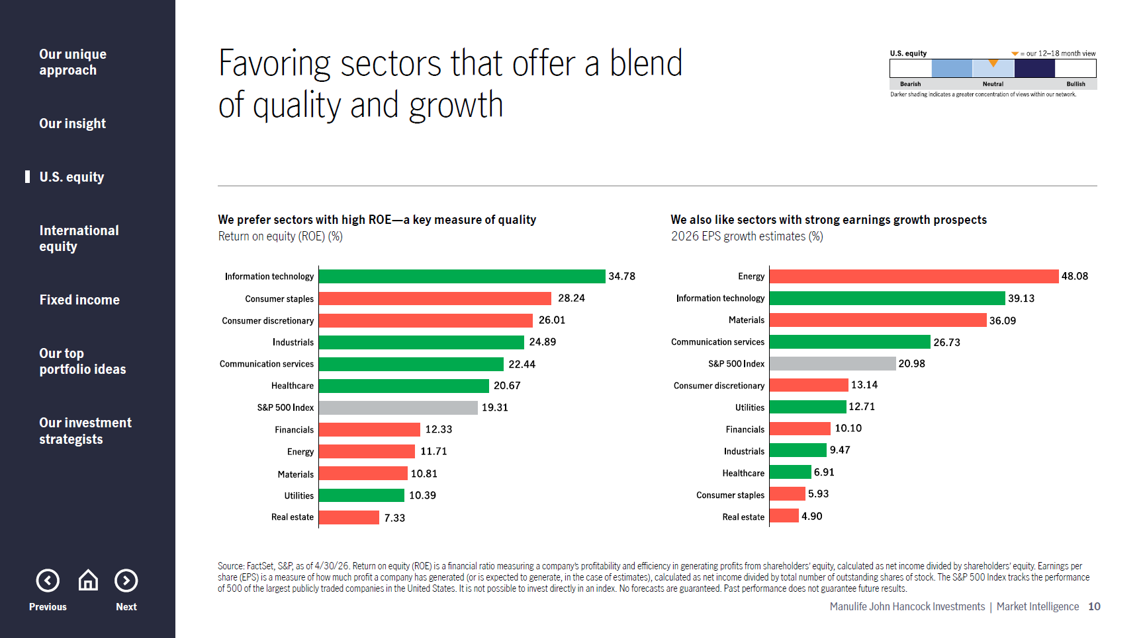
Notes:
Slide 10
Our current sector positioning reflects a preference for areas that combine quality characteristics with reasonable valuations and solid growth potential. Quality is evidenced by strong balance sheets, high returns on equity (ROE), and relatively low leverage.
Information technology remains a favored quality sector, supported by strong ROE and robust earnings growth, although we acknowledge that valuations remain elevated. With that in mind, we also emphasize the value factor through exposure to sectors and companies trading at more reasonable valuations, while seeking to avoid unprofitable businesses.
Within value, we favor the defensive healthcare sector, which offers decent earnings growth, solid ROE, and reasonable valuations, along with lower earnings volatility. We also like utilities as another defensive area that could benefit from a potential market rotation going forward.

Slide 12
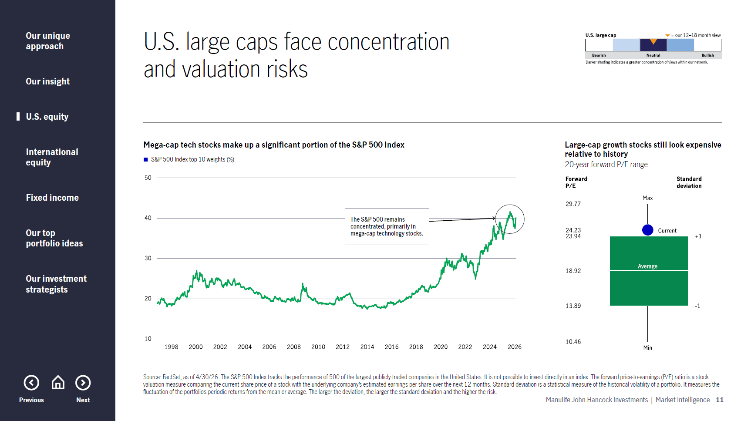
Notes:
Slide 11
The chart on the left highlights the elevated concentration risk in the S&P 500 Index, a key factor behind our neutral stance on U.S. equities. Over the past decade, the weight of the top 10 stocks in the index has continued to rise and currently sits at around 40%. That’s a lofty level by historical standards and, notably, even more concentrated than during the late‑1990s tech bubble.
On the right, we see that large‑cap growth stocks also appear expensive relative to their 20‑year valuation history (as measured by forward P/E ratio). While we continue to like some high‑quality mega‑cap companies, the combination of elevated valuations and concentration risk leads us to maintain a neutral view on large-cap U.S. equities overall.

Slide 13
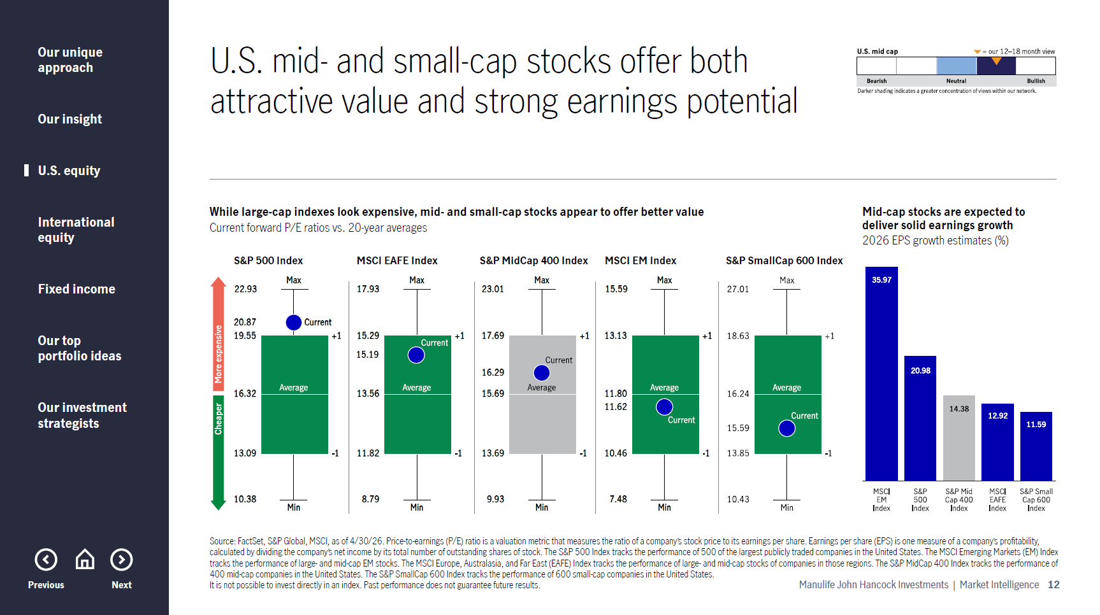
Notes:
Slide 12
Mid‑cap stocks remain a favored area within U.S. equities, particularly as a way to help manage valuation risk in large caps. The chart on the left shows forward price-to-earnings multiples for mid-cap, large‑cap, and small-cap stocks relative to their long-term averages. As shown, mid caps are trading slightly above their long-term historical average but at a meaningful discount to large caps.
On the right, earnings expectations also support this positioning. Mid caps are expected to deliver solid EPS growth in 2026, potentially making them attractive from both a valuation and growth perspective.

Slide 14
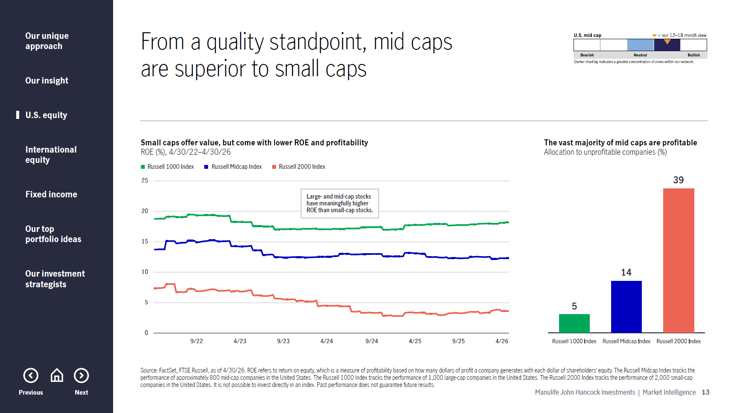
Notes:
Slide 13
Small‑cap stocks may look relatively inexpensive on the surface, but they currently come with lower profitability and quality than bigger companies. As shown on the left, return on equity is materially higher for large‑ and mid‑cap stocks as compared to small caps.
On the right, 39% of small‑cap companies are unprofitable, versus just 14% for mid caps and 5% for large caps. This reinforces our emphasis on profitable, reasonably valued companies and supports our continued conviction in mid‑cap equities.

Slide 15
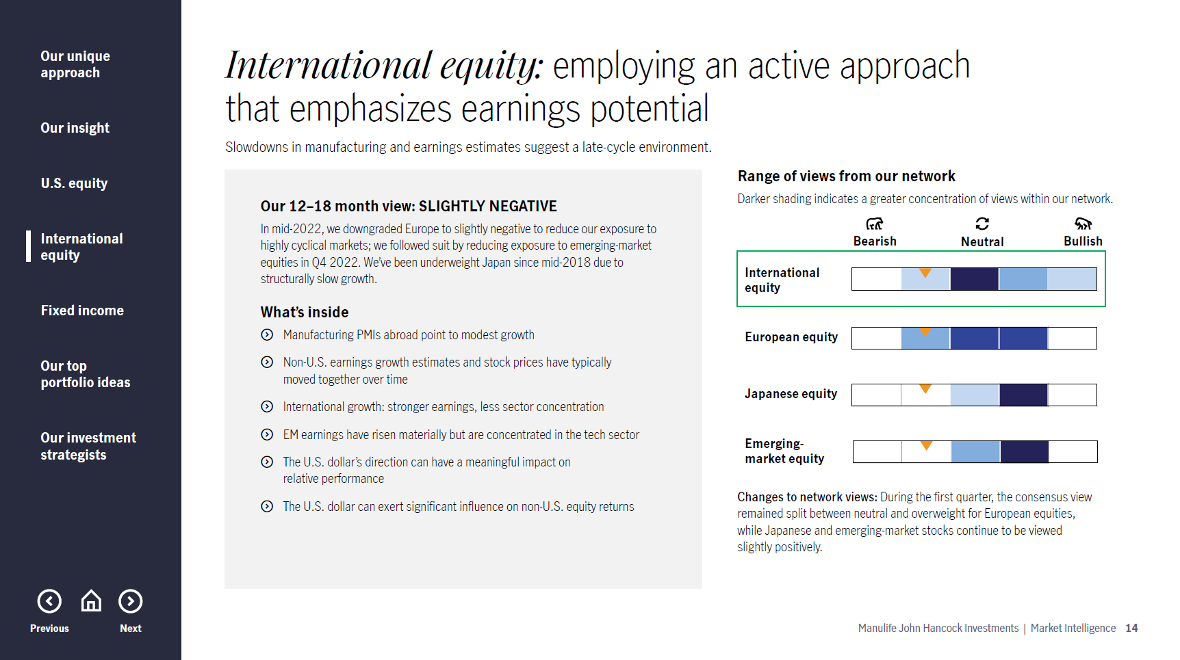
Notes:
Slide 14
Turning to international equities, we remain modestly underweight non‑U.S. markets overall. This reflects our preference for quality, where U.S. equities tend to have a higher concentration of high‑quality companies, as well as signs of late‑cycle activity overseas.
While we of course continue to maintain international exposure for diversification benefits, we generally favor U.S. equities given their stronger fundamentals and quality characteristics at this point in the cycle.

Slide 16
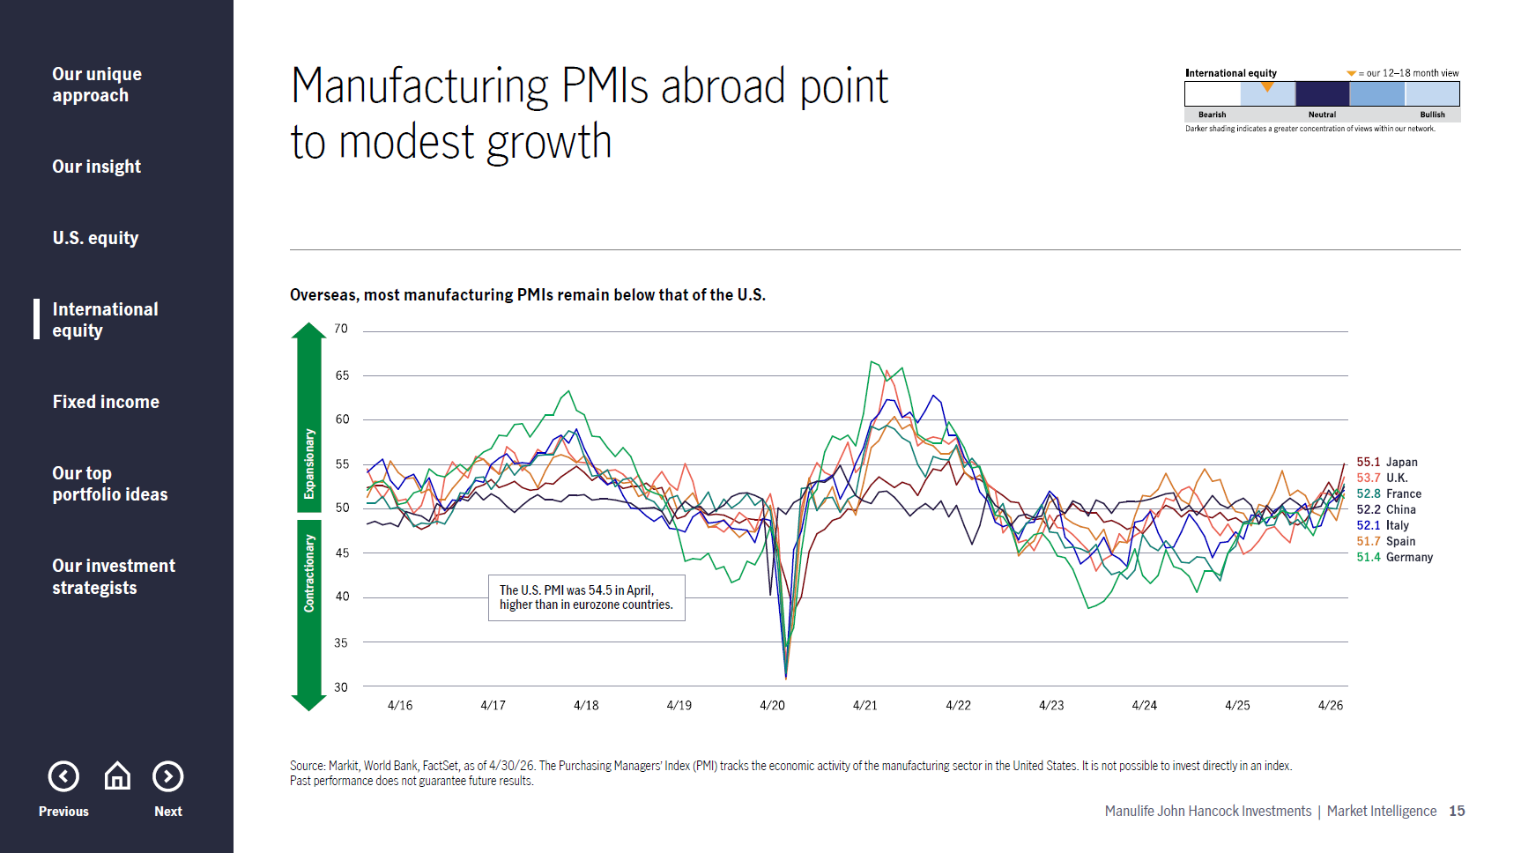
Notes:
Slide 15
This chart looks at global manufacturing activity through PMI readings across major developed markets and China. PMI levels above 50 signal expansion, while readings below 50 indicate contraction.
Today, PMI levels vary somewhat across regions, with the United States continuing to hold up better than Europe and China after posting a PMI reading of 54.5 in April 2026. In periods of desynchronized global growth, an emphasis on quality has historically been a prudent approach.

Slide 17
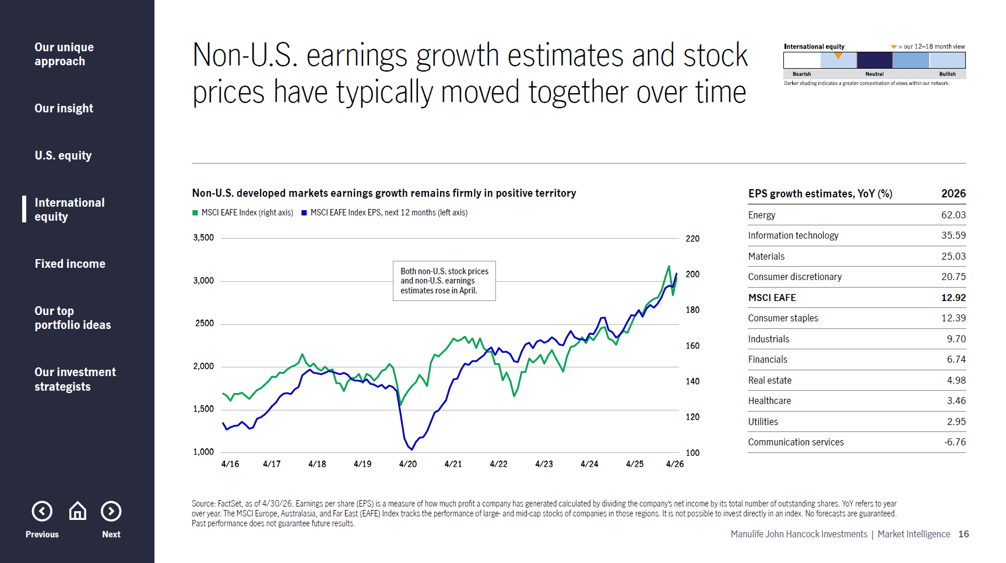
Notes:
Slide 16
Historically, non‑U.S. equity prices and earnings expectations tend to move together. Both rose in April 2026, leaving overseas developed markets earnings growth firmly in positive territory and stock prices also still higher on a year‑over‑year basis.
This environment highlights the importance of active management overseas, where bottom-up security selection can capitalize on sector-level earnings improvements. While 2026 earnings growth looks reasonably strong—particularly in certain sectors—we’d want to see a more durable earnings engine to become more constructive on non‑U.S. equities overall.

Slide 18
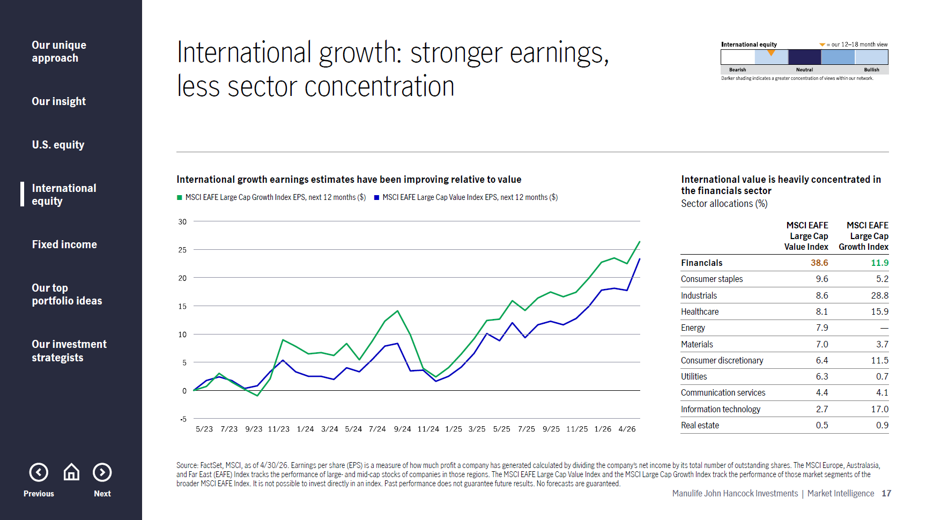
Notes:
Slide 17
From a style standpoint, we currently favor international growth over international value. Growth stocks generally offer stronger earnings momentum and less sector concentration.
As shown here, earnings estimates for international growth have continued to improve relative to value. In contrast, the value index remains heavily concentrated in the financials sector, which adds risk in a late‑cycle environment.

Slide 19
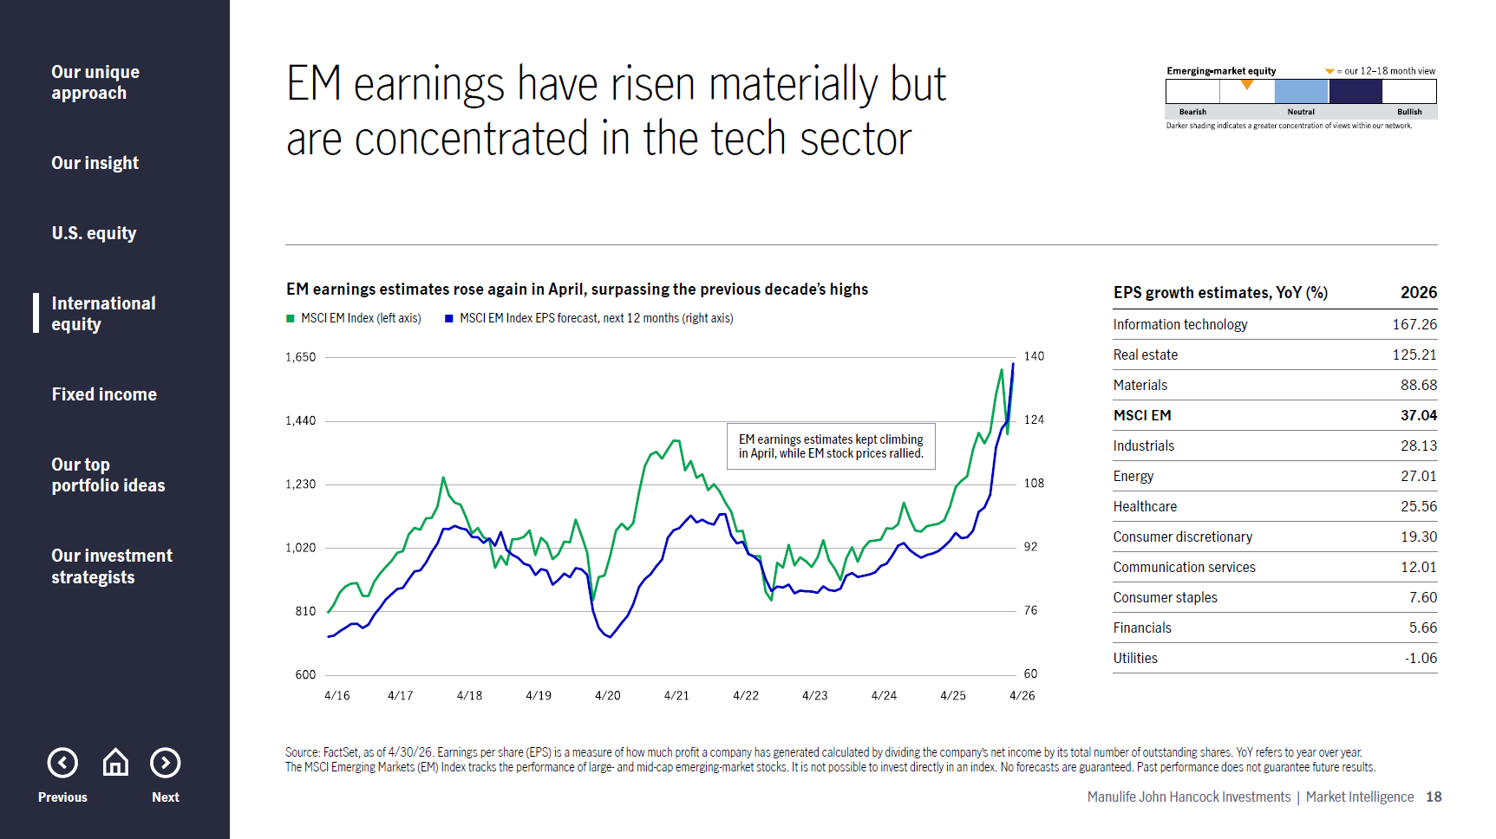
Notes:
Slide 18
Emerging-market earnings estimates reached new highs in April 2026, although in some cases, we believe expectations are overly optimistic. Meanwhile, EM equity prices rallied after dipping modestly earlier in the year.
Looking ahead, 2026 earnings growth estimates remain elevated. From a portfolio standpoint, we continue to take a selective approach, including China where appropriate, while recognizing that some investors now favor EM ex‑China exposures.

Slide 20
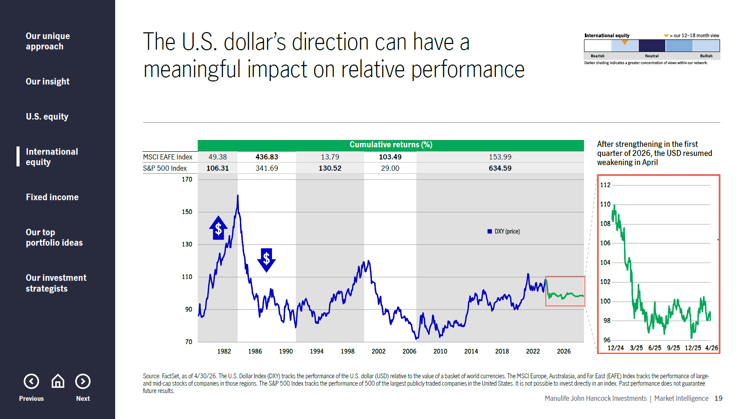
Notes:
Slide 19
Currency cycles can materially influence international returns. Historically, non‑U.S. equities tend to underperform during periods of U.S. dollar strength and outperform when the dollar weakens.
After weakening through much of 2025, the dollar strengthened in the first quarter of 2026, only to resume its weakening trend in April. While currency is not a primary driver of our views due to its volatility, it remains an important contextual factor.

Slide 21
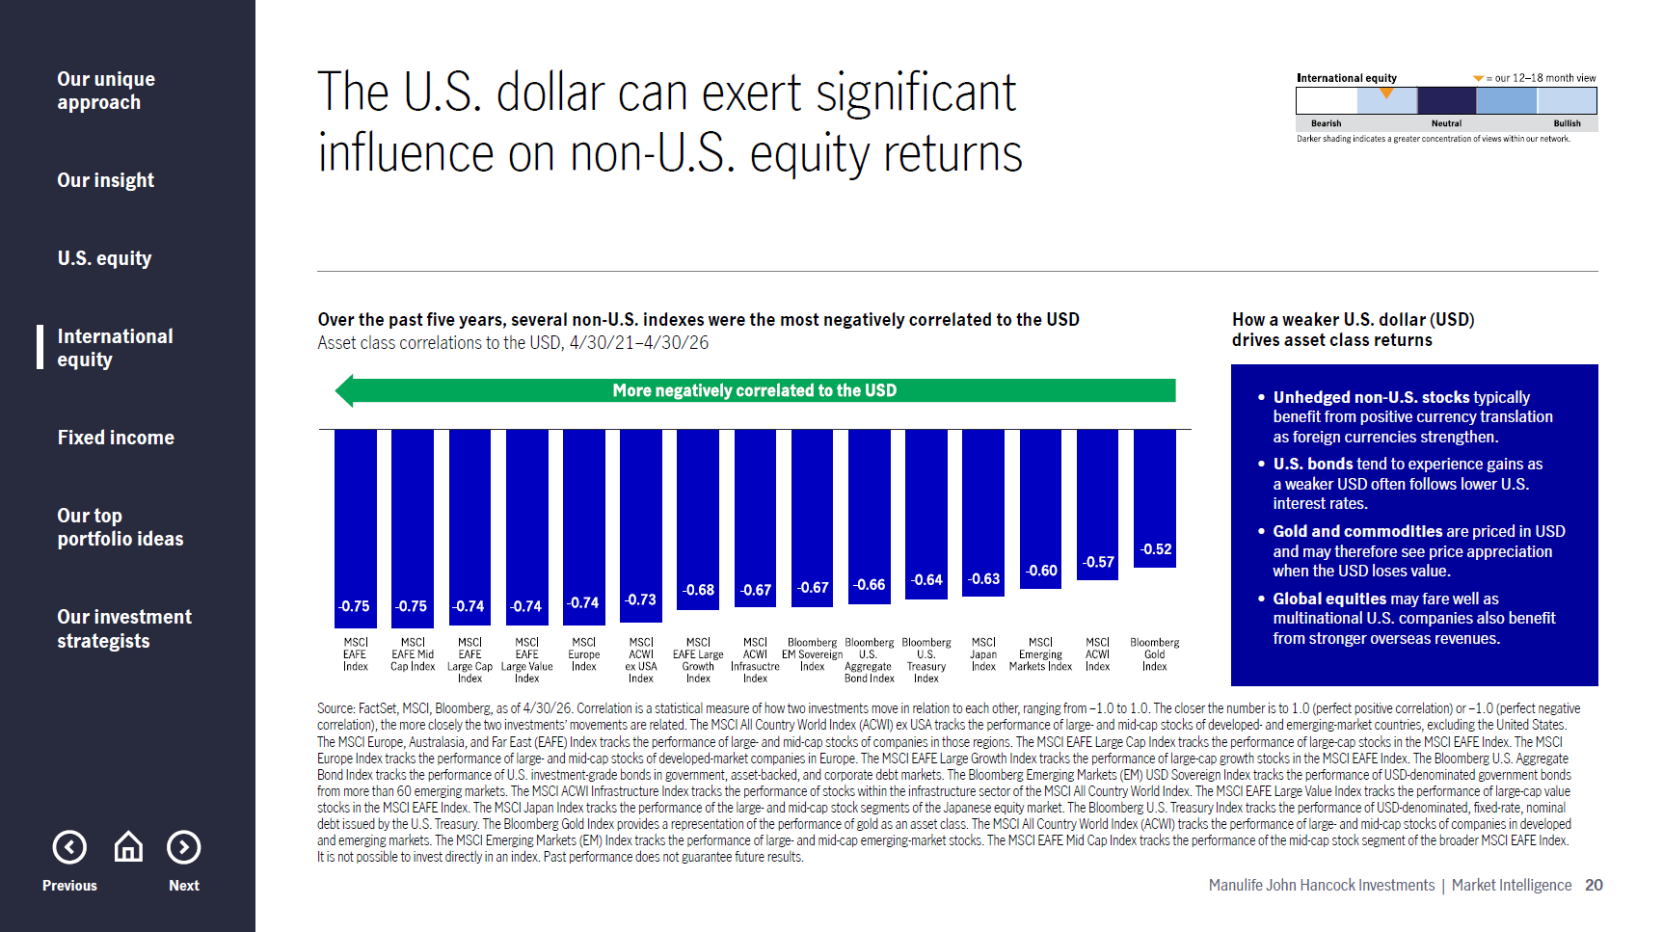
Notes:
Slide 20
This chart further illustrates how asset classes respond to U.S. dollar movements. Over the past five years, several non‑U.S. equity indexes have exhibited some of the strongest negative correlations to the dollar.
In periods of dollar weakness, unhedged international equities can benefit from currency translation, while globally diversified portfolios may also benefit as multinational revenues translate more favorably.

Slide 22
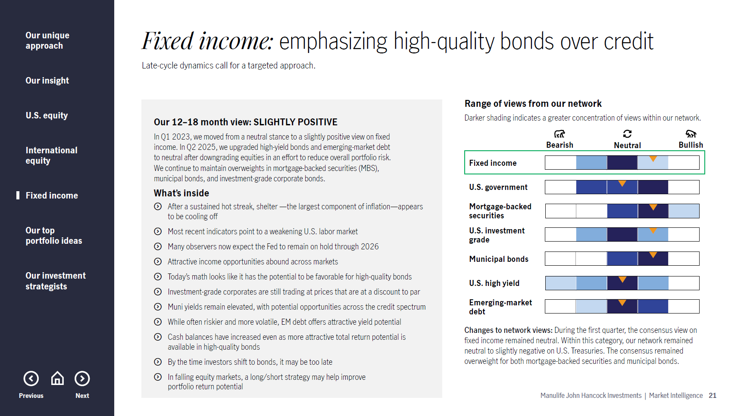
Notes:
Slide 21
Turning to fixed income, we maintain a modest overweight in bonds overall in what we view as a late‑cycle environment. We believe that income levels remain attractive, particularly in high‑quality bond sectors.
We’re neutral on U.S. Treasuries, overweight mortgage-backed securities, investment-grade corporates, and municipals, and neutral on both high yield and emerging-market debt. A diversified core or core‑plus strategy focused on quality and intermediate duration aligns well with these views.

Slide 23
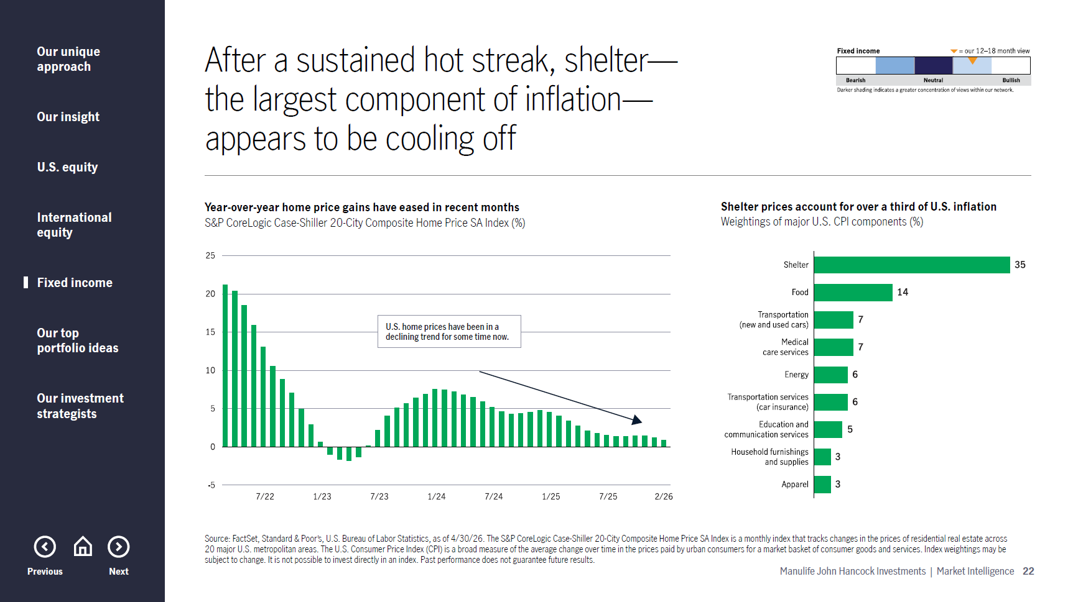
Notes:
Slide 22
Turning to the inflation picture, one key area we continue to watch closely is the U.S. housing market. Shelter remains the single largest component of CPI, accounting for over one-third of overall inflation, making housing trends especially important for fixed-income investors.
As shown here, year‑over‑year home price growth has continued to cool after a sustained period of strength. That moderation suggests that shelter inflation pressures may ease further over time. If this trend persists, it could help offset inflation coming from other areas such as energy, where higher prices have recently weighed on consumers. Overall, continued cooling in housing could be supportive of bonds and the broader inflation outlook.

Slide 24
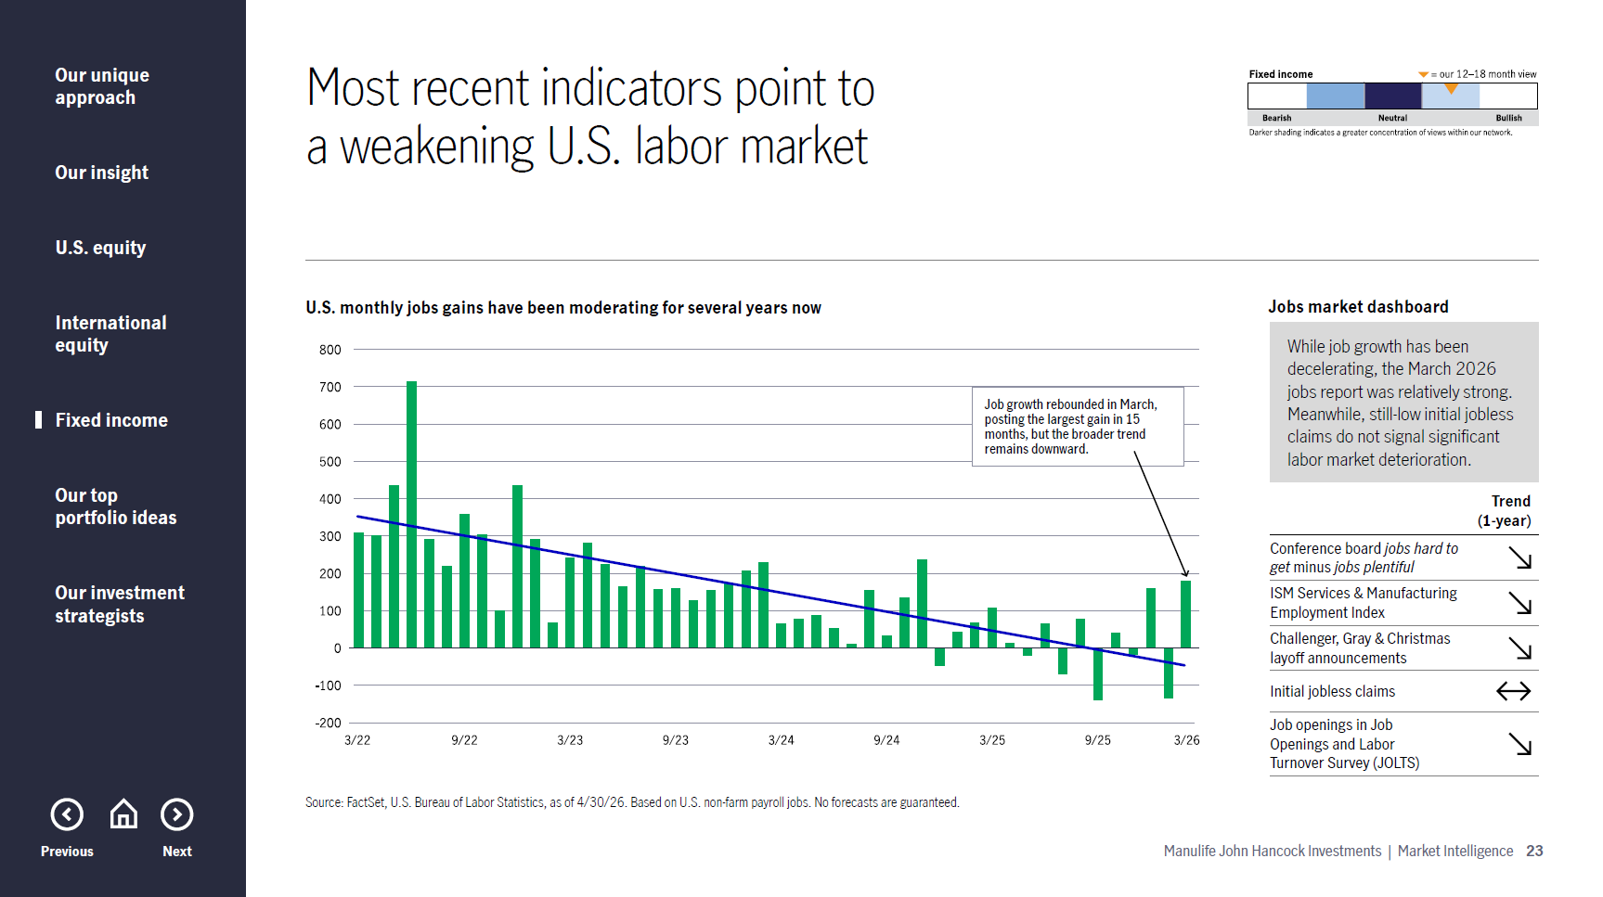
Notes:
Slide 23
Another critical component of the macro backdrop is the U.S. labor market, particularly given the U.S. Federal Reserve's dual mandate to maintain price stability while maximizing employment. While inflation is a key focus for policymakers, labor conditions are also important in shaping the policy outlook.
The chart on the left shows that monthly job gains have been moderating for several years and briefly turned negative in February 2026, before rebounding in March. However, the broader trend still points to cooling labor momentum. At the same time, initial jobless claims remain relatively low and do not yet signal significant deterioration.

Slide 25
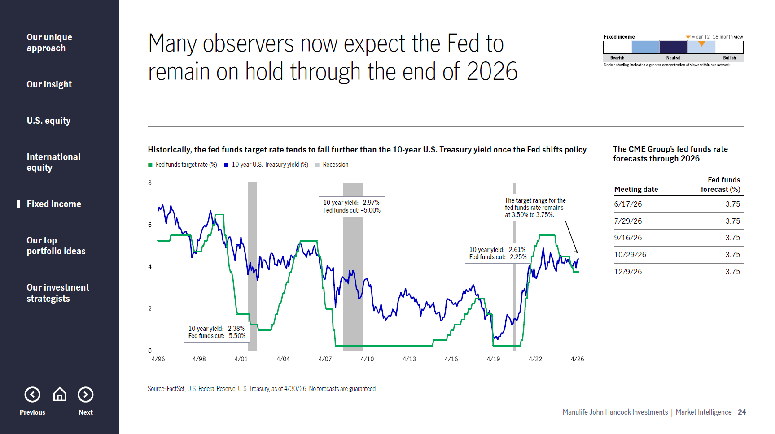
Notes:
Slide 24
Speaking of the Fed, it’s helpful to look at how interest rates have historically behaved once the Fed shifts direction. This chart shows that during prior easing cycles, the federal funds rate has typically declined more than longer‑term yields, such as the 10‑year Treasury.
Even if the Fed remains on hold in the coming months, or perhaps adopts a more hawkish policy stance in response to higher inflation, history suggests rates often end a cycle lower than where they began. As shown in the table on the right, the CME Group currently expects the Fed to hold rates steady through the end of 2026. That backdrop would support our constructive view on high‑quality fixed-income assets.

Slide 26
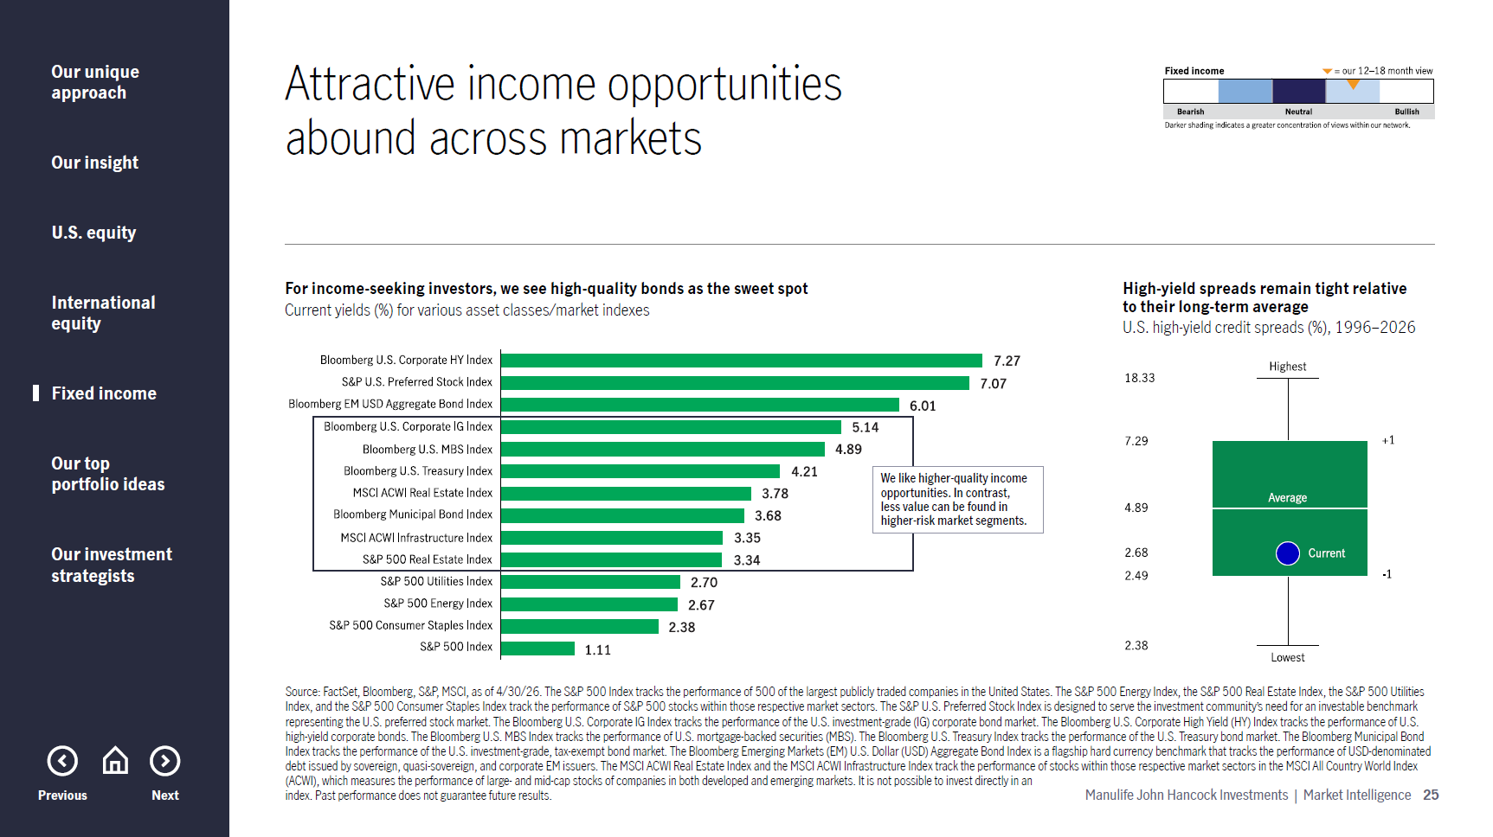
Notes:
Slide 25
So where can investors find attractive income today? The chart on the left compares yields across equities, sectors, and fixed‑income markets. As shown, equity income potential has declined meaningfully as stock valuations have risen, with the S&P 500 dividend yield now near historic lows.
While high‑yield bonds currently offer elevated yields, credit spreads remain tight relative to history, limiting compensation for added risk. In contrast, high-quality bonds, such as investment-grade corporates, mortgage-backed securities, and Treasuries, continue to offer attractive income without requiring investors to take excessive credit or duration risk.

Slide 27
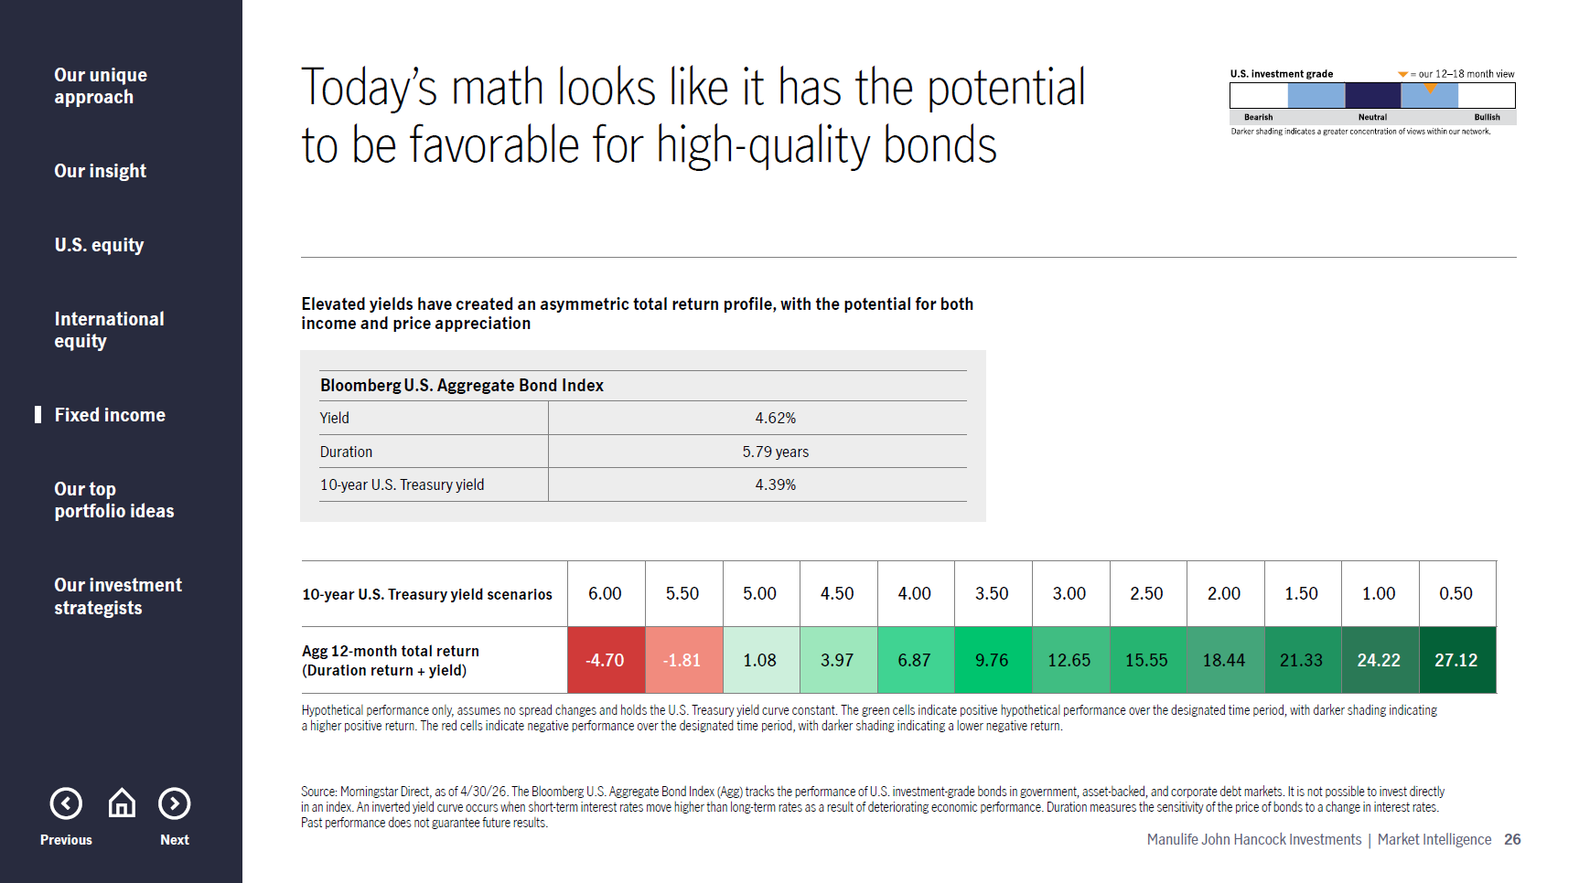
Notes:
Slide 26
This slide illustrates the asymmetry in today’s bond market. Using duration and current yield, we can estimate potential outcomes under different rate scenarios. In a worst‑case scenario where the 10‑year Treasury yield rises meaningfully, losses are relatively contained.
Conversely, if yields fall, even modestly, bonds are positioned to deliver positive total returns. Should rates move closer to pre‑pandemic levels, the return potential becomes even more compelling. This asymmetric profile reinforces why we continue to view high‑quality fixed income as an attractive risk‑management and income-generating tool in portfolios.

Slide 28
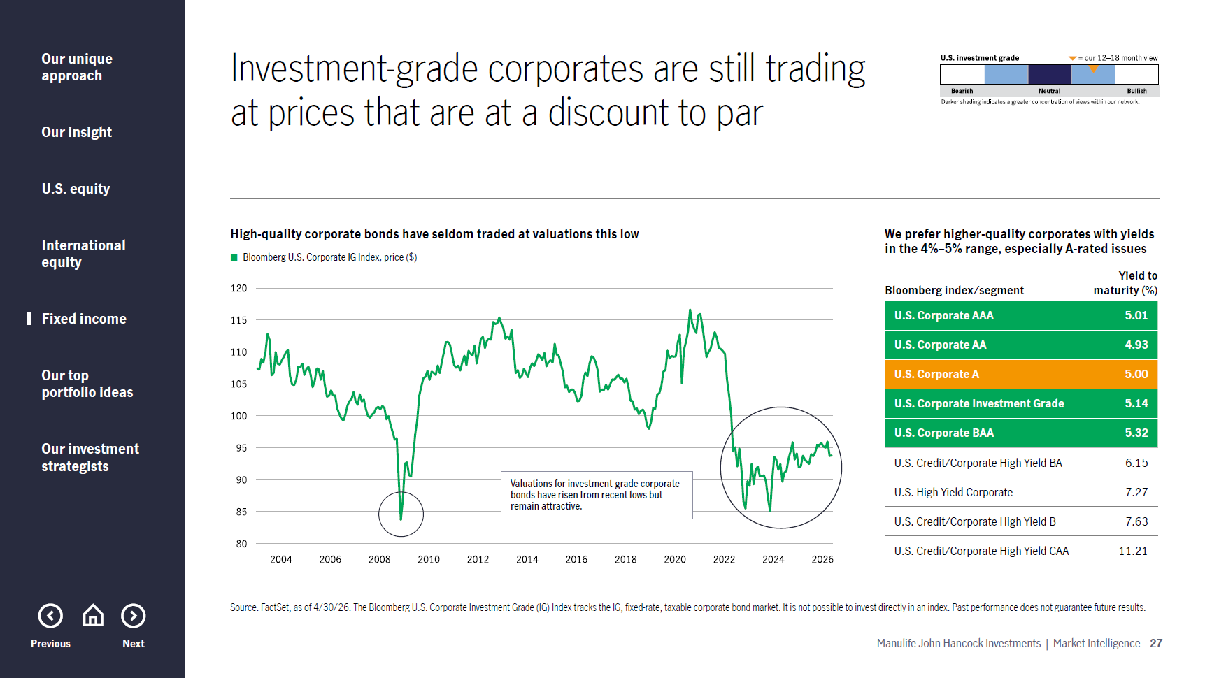
Notes:
Slide 27
Investment‑grade corporate bonds remain a particularly attractive segment within fixed income. While valuations have moved off recent lows, they remain favorable relative to history and have rarely been this attractive outside of periods of significant market stress.
Looking across the credit spectrum, we favor higher‑quality corporates, especially single‑A-rated issuers, that offer competitive yields with relatively low default risk. Further down the credit spectrum, yields get progressively higher, but we believe tight high‑yield spreads limit compensation for incremental risk, reinforcing our preference for quality.

Slide 29
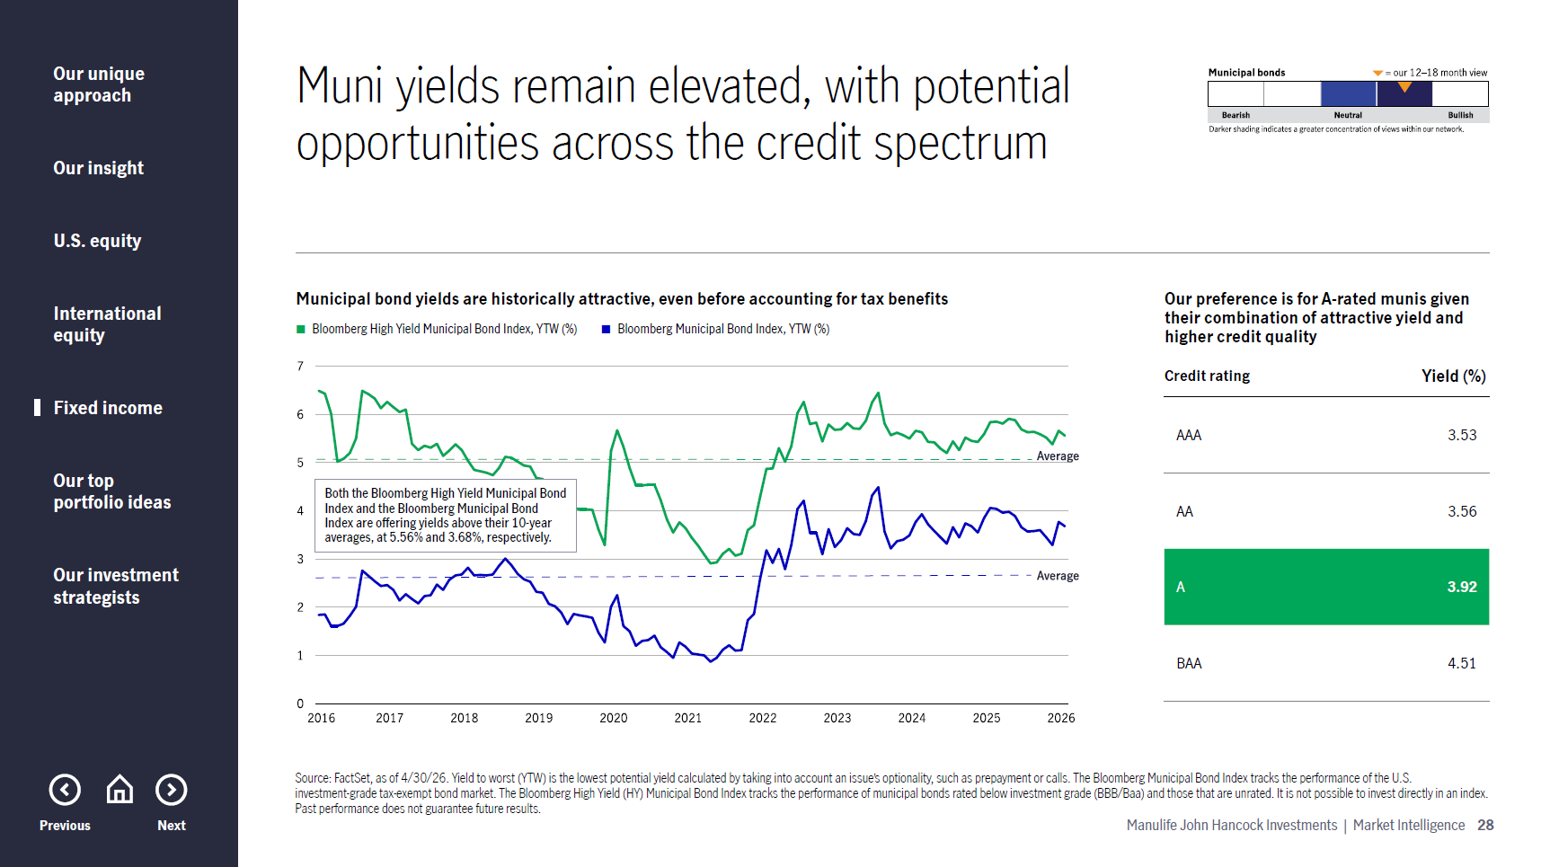
Notes:
Slide 28
Municipal bonds (munis) are another area where we continue to find compelling opportunities. Their yields remain elevated relative to history, even before accounting for the tax advantages that munis provide. Both high-yield and investment-grade municipal indexes currently offer yields above their 10-year averages.
Fundamentals also remain generally supportive, with many municipalities benefiting from healthy balance sheets and strong tax receipts. Importantly, investors can access attractive income without moving down in credit quality. Our preference remains for A‑rated munis, which offer a balance of yield and credit strength.

Slide 30
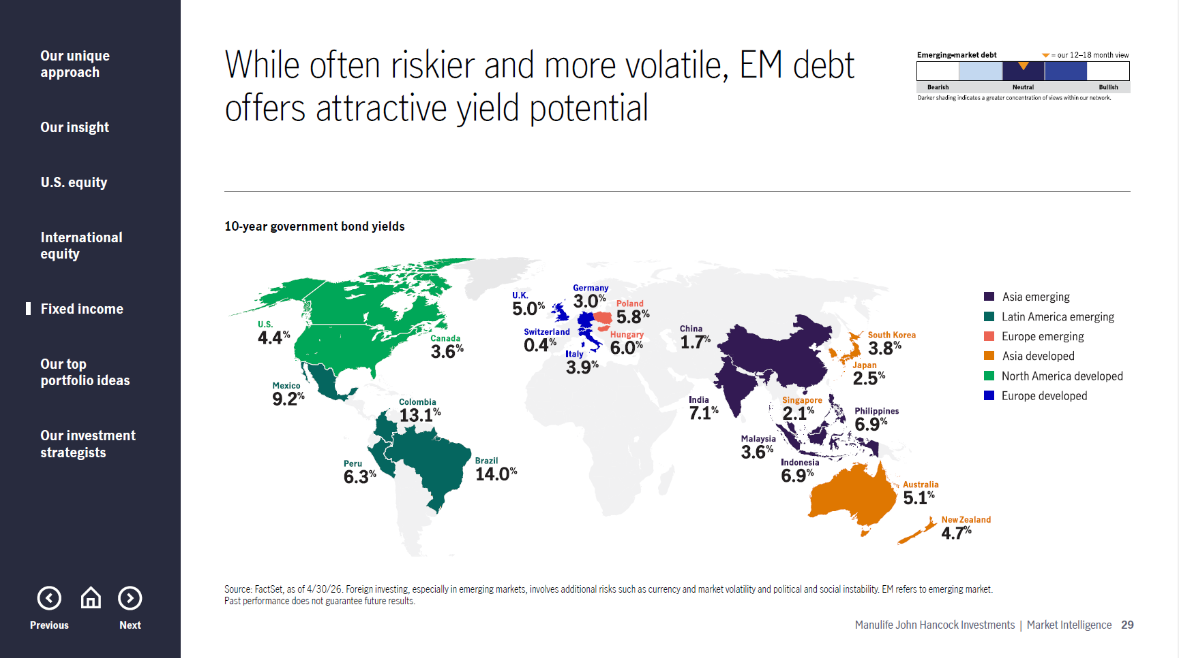
Notes:
Slide 29
While much of our fixed‑income focus is domestic, there are selective opportunities overseas, particularly in emerging‑market debt. As shown here, 10‑year government bond yields in several emerging markets remain meaningfully higher than in developed markets.
That said, EM debt carries higher credit and currency risks, requiring a cautious and selective approach. While we are generally conservative with broad allocations, we believe that actively managed EM debt can play a role within a diversified, multi-sector fixed-income portfolio.

Slide 31
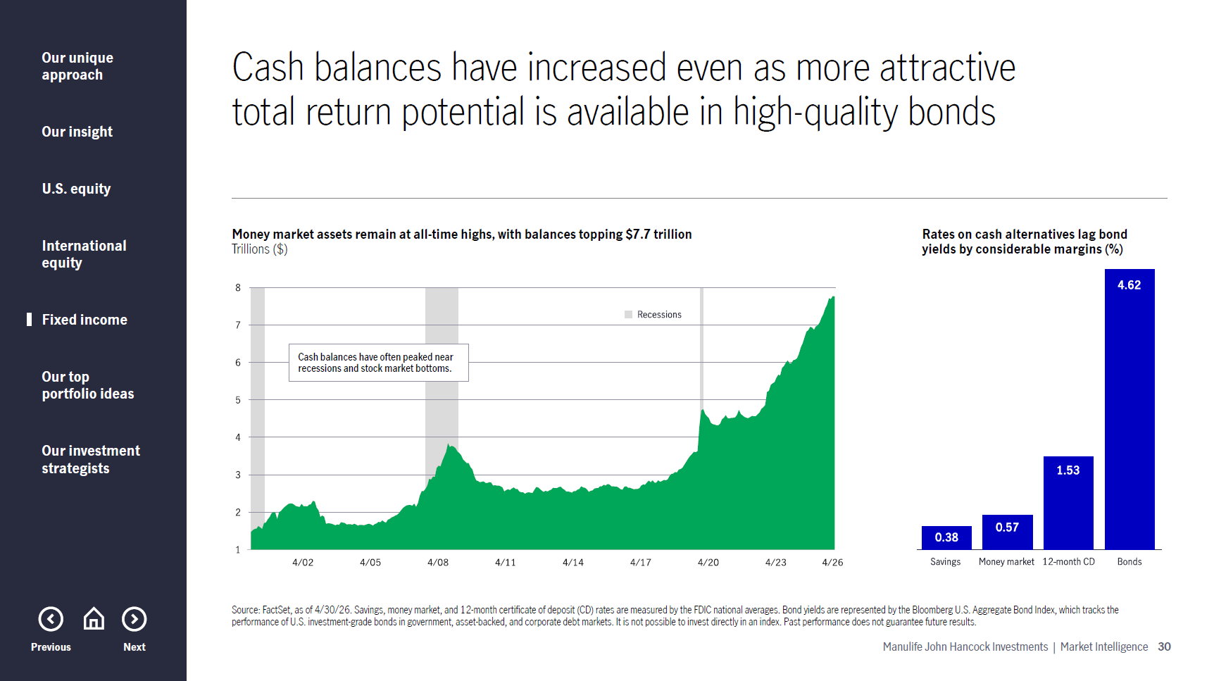
Notes:
Slide 30
One notable dynamic across markets today is the significant amount of cash sitting on the sidelines. Money market assets remain elevated at more than $7.7 trillion, reflecting caution following recent market volatility.
However, the chart on the right shows that yields on cash alternatives meaningfully lag bond yields. This large cash build‑up suggests investor sentiment remains restrained and highlights the opportunity cost of staying in cash when higher‑quality bonds offer more attractive income and higher total-return potential.

Slide 32
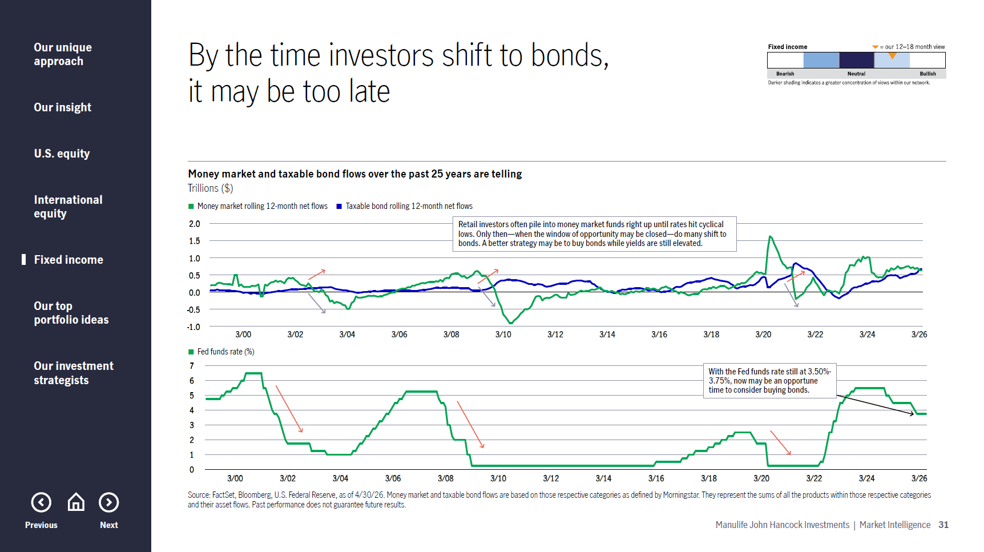
Notes:
Slide 31
Historically, many investors wait to move out of cash until after bond yields have already fallen. Asset flow data suggests reallocations often occur too late in the cycle, reducing the opportunity to lock in higher yields.
Given today’s environment—with interest rates still relatively high by historical standards and high‑quality bond yields still attractive—we believe this may be an opportune time to initiate or add to high-quality fixed-income allocations. Locking in income today may prove more beneficial than remaining heavily allocated to cash.

Slide 33
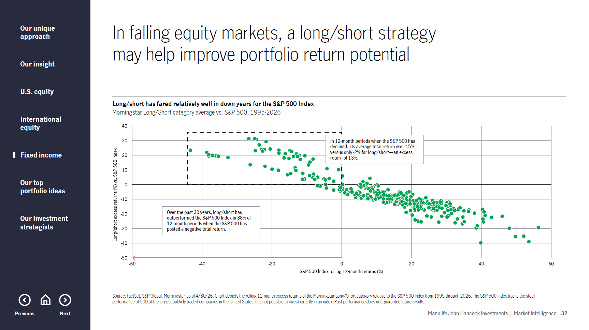
Notes:
Slide 32
Finally, we’ll touch briefly on alternatives. Certain alternative strategies can help reduce portfolio volatility and enhance diversification, particularly in more challenging market environments.
As shown here, long/short equity strategies have historically performed relatively well during years when the S&P 500 declines. While not appropriate for every investor, we believe thoughtfully incorporated alternatives can complement traditional stock and bond allocations in a diversified long‑term portfolio.

Slide 34
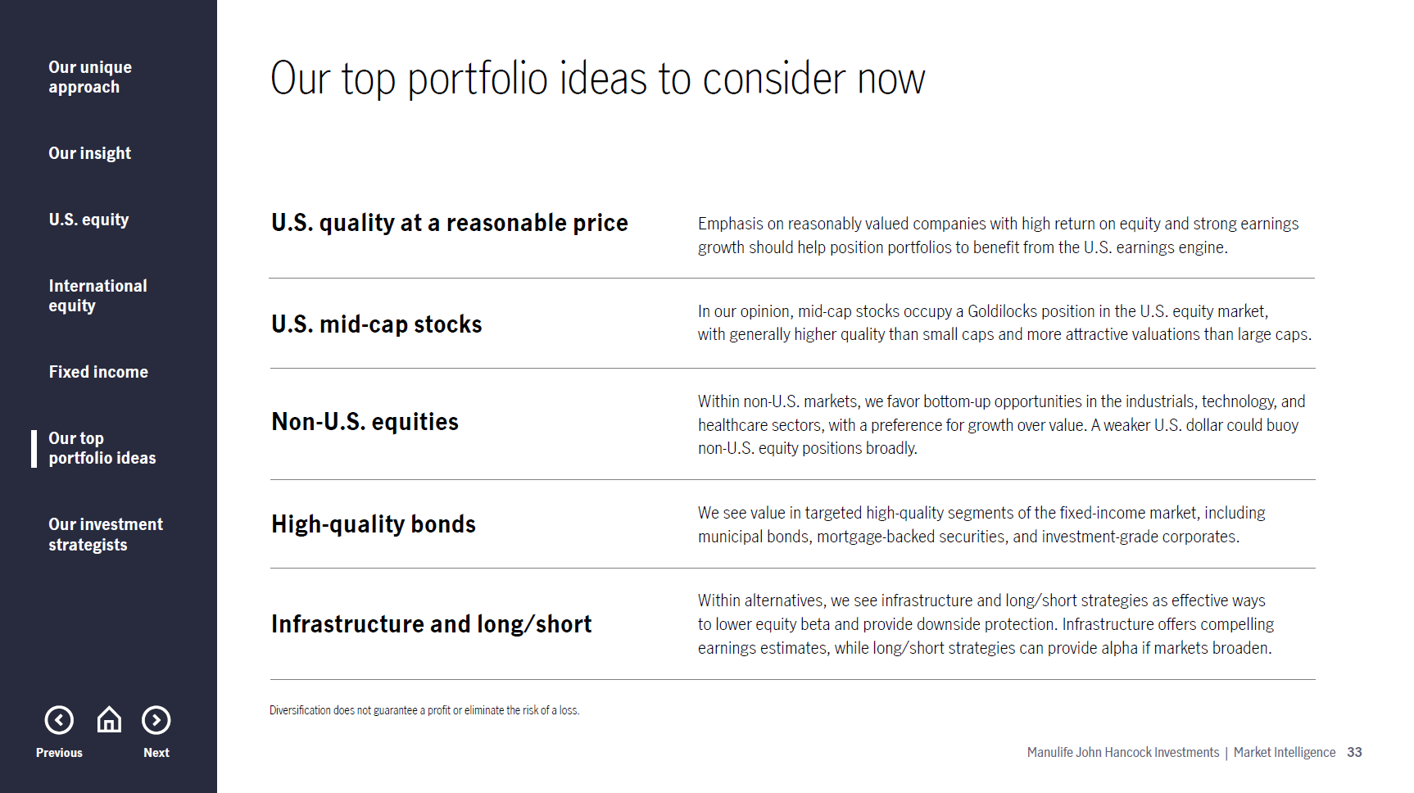
Notes:
Slide 33
To wrap up, our top five portfolio ideas to consider in today’s market environment are as follows:
U.S. quality at a reasonable price
U.S. mid-cap stocks
Non-U.S. equities
High-quality bonds
Infrastructure and long/short

Slide 35
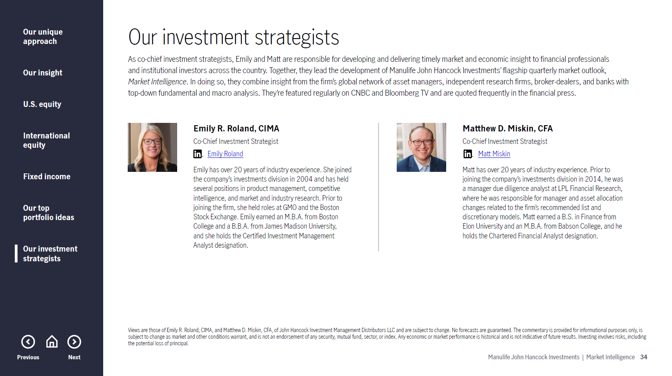

Slide 36
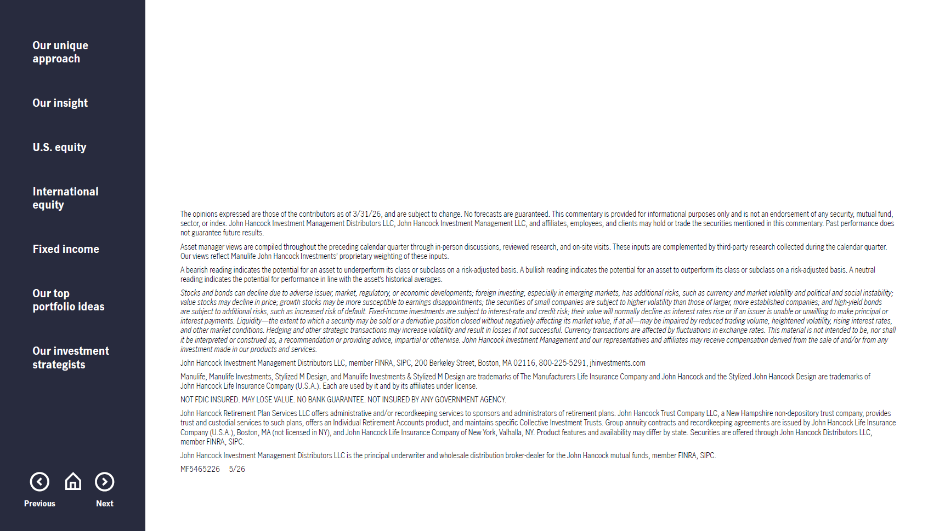
MF5477744 5/26

